Slide 1

ESSA
Eligibility Changes

Slide 2
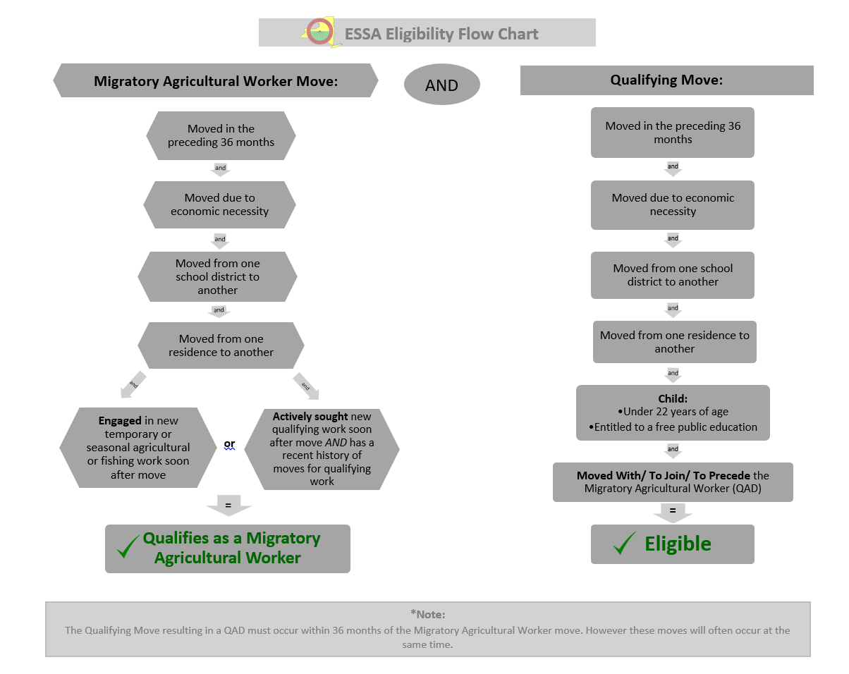

Slide 3
Timeline scenario

Slide 4

Step 1: Migratory Agricultural worker move
  On July 1, 2017, Carlos moves from Albany, NY to Syracuse, NY on his own and engages in work soon after the move planting trees at a nursery. On this date, Carlos becomes a Migratory Agricultural Worker, and will be considered a Migratory Agricultural Worker for 36 months (until July 1, 2020).

Slide 5
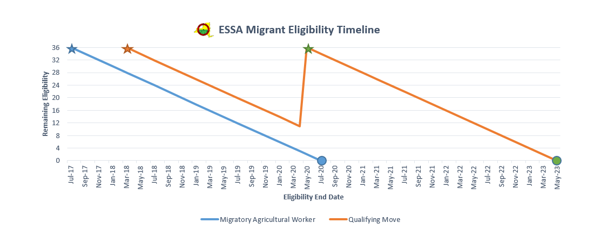
July 1, 2017 - Carlos becomes a Migratory Agricultural Worker.
July 1, 2020- Carlos’s Migratory Agricultural Worker eligibility expires.

Slide 6
Step 2: qualifying move
A few months later, Carlos returns to his family in Albany, NY. On March 15, 2018, Carlos, his wife, and 2 young children move from Albany, NY to Plattsburgh, NY, where Carlos finds a job working in a restaurant. The family has made a Qualifying Move (a move due to economic necessity from one school district to another) with a Migratory Agricultural Worker. The children qualify for MEP services, and will have eligibility for 36 months from the date of the move (until March 15, 2021).

Slide 7
March 15, 2018- The two children qualify for the MEP. This date is the Qualifying Arrival Date, or QAD (the date the worker and children both complete the qualifying move).

Slide 8
Step 3: additional qualifying move(s)
Carlos and his family live in Plattsburgh for over a year, until he loses his job when the restaurant he works at closes. The family moves from Plattsburgh, NY to Watertown, NY on May 2, 2020, where Carlos and his wife are both able to find work at the local hospital. The family has made another Qualifying Move (a move due to economic necessity from one school district to another) with a Migratory Agricultural Worker. The children re-qualify for MEP services, and will have eligibility for 36 months from the date of the move (until May 2, 2023).

Slide 9
May 2, 2020- The two children re-qualify for the MEP. This date is a new QAD. The children will receive another 36 months of eligibility from this date.
May 2, 2023- The children’s eligibility for the MEP expires.

Slide 10
The Old and New Laws
ESSA- Every Student Succeeds Act
Replaces
NCLB- No Child Left Behind

Slide 11
What Remains the Same?
Child Eligibility- Ages birth through age 21, who are entitled to a free public education in the State (or are not yet at a grade level at which the local educational agency (LEA) provides a free public education- Ex: preschool children)
Children who moved:
  As a migratory agricultural worker or migratory fisher, OR
  With, to join, or to precede a parent/guardian or spouse who is a migratory agricultural worker or migratory fisher
Migratory children are eligible for the MEP for 36 months from their most recent qualifying arrival date (QAD)

Slide 12
What Remains the Same?
Qualifying Work
OME uses the abbreviated term “Qualifying Work” to mean temporary or seasonal employment (or personal subsistence) in agriculture or fishing.
“Temporary Employment,” “Seasonal Employment,” and “Personal Subsistence” maintain the same definitions.
Employment in Agriculture: Same definition of “agricultural work” (with the addition of dairy work or the initial processing of raw agricultural products).
Employment in Fishing: Same definition.

Slide 13
Qualifying Move and Qualifying Arrival Date
Qualifying Move
Due to economic necessity; and
From one residence to another; and
From one school district to another school district.
Qualifying Arrival Date
Date that begins a migratory child’s 36 months of eligibility.
The date that the child moves as a migratory agricultural worker or, (if the child is not the worker) the date that the child moves with, or to join, the worker.
If the child and worker moved together, QAD = The date they arrived in the district.
To Join Moves:
  If the child moved before the worker, QAD = The date that the worker arrived.
  If the child moved after the worker, QAD = The date that the child arrived.

Slide 14
What Has Changed?
Migratory Agricultural Worker
It is no longer necessary to determine whether the worker moved “in order to obtain” qualifying work, or any employment.
“Engaged” in qualifying work soon after the move instead of “obtained.”
Modified criteria for individuals who did not engage in new qualifying work soon after their qualifying move.

Slide 15
Migratory Agricultural Worker Move
NCLB (old)
ESSA (new)
Moved in the preceding 36 months
Due to economic necessity
Across school district lines
From one residence to another
In order to obtain qualifying work
Moved in the preceding 36 months
Due to economic necessity
Across school district lines
From one residence to another
In order to obtain qualifying work
Engaged in qualifying work soon after the move (within 60 days)

Slide 16

Migratory Agricultural Worker Move
Engaged in Qualifying Work Soon After the Move
Made a
Qualifying Move
Within the past 36 months
Engaged in Qualifying Work
Soon After Move (Within 60 days)
AND
AND
For Economic Necessity
Across School District Lines
AND

Slide 17
Migratory Agricultural Worker Move
NCLB (old)
ESSA (new)
Moved in the preceding 36 months
Due to economic necessity
Across school district lines
From one residence to another
In order to obtain qualifying work specifically, but did not obtain the work.
Moved in the preceding 36 months
Due to economic necessity
Across school district lines
From one residence to another
In order to obtain qualifying work specifically but did not obtain the work.
Actively sought new qualifying work, AND has a recent history of moves for qualifying work.

Slide 18
Migratory Agricultural Worker Move
Did Not Engage in Qualifying Work Soon After the Move
Made a
Qualifying Move
Within the past 36 months
Did Not Engage in Qualifying Work
Soon After Move
AND
AND
For Economic Necessity
Across School District Lines
Actively Sought Qualifying Work Soon After Move
Worker has Recent History of Moves
AND
AND

Slide 19

Key Points
An individual no longer has to have the intent to obtain agricultural work at the time of the move, as long as he/she engages within 60 days.
The Qualifying Move and the Migratory Agricultural Worker Move to obtain qualifying work are separate components. They can occur at the same time OR on separate occasions.
An individual can establish Migratory Agricultural Worker status on his/her own.
A Qualifying Move resulting in a new Qualifying Arrival Date (QAD) can be made even if the move is unrelated to a qualifying activity, as long as the move is made with or to join a Migratory Agricultural Worker.

Slide 20
Key Terms
Soon After
Within 60 days after the Qualifying Move
Actively Sought
May occur before or after the qualifying move (Ex: Applied for qualifying work at a particular agricultural job site, applied for such employment before moving, or moved reasonably believing that, based on newspaper ads or word of mouth, such work would be available after the move.)
Must occur “soon after” the move (within 60 days.)
Recent History of Moves for...
Moves that resulted in engagement in qualifying work;
At least two moves;
Within 36 months of the recruiter’s interview.

Slide 21
scenarios

Slide 22
Scenario 1
On June 1, 2017, Jessica moves with her two children, ages 6 and 8, from Dallas, TX to South Fallsburg, NY to live with relatives after losing her job in Dallas. Jessica is hoping to find work similar to her last job in housekeeping, but finds that she can earn more money in a job at a poultry-processing facility. She only plans to stay for a few months to save money, and begins work deboning chicken at the poultry plant on July 15, 2017.
Are Jessica’s children eligible for the MEP?

Slide 23
Scenario 1
Are Jessica’s children eligible for the MEP? Yes
Migratory Agricultural Worker: Is the parent/guardian/spouse or the child himself a Migratory Agricultural Worker? Yes. The children's’ mother is a Migratory Agricultural Worker because she made a qualifying move in the preceding 36 months, soon after which she engaged in new qualifying work.
Qualifying Move: Did the children make a “Qualifying Move” (Due to economic necessity, from one residence to another, and from one school district to another) within the preceding 36 months? Yes
Child: Are the children under the age of 22 and still entitled to a free public education in the state? Yes
With/To Join: Did the children make the Qualifying Move on their own as or with/to join a parent/guardian/spouse who is a Migratory Agricultural Worker? Yes

Slide 24
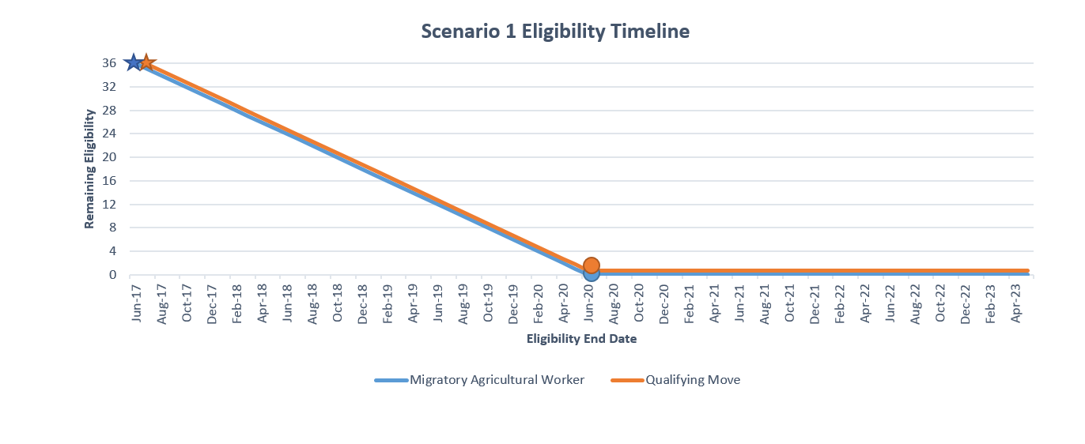
June 1, 2017- Jessica becomes a Migratory Agricultural Worker.
June 1, 2020- Jessica’s eligibility as a MAW expires.
June 1, 2017- Jessica’s children become eligible for MEP services after making a Qualifying Move.
June 1, 2020- Children’s eligibility for MEP services expires.

Slide 25
Scenario 2
Paul, age 13, lived with his parents in Buffalo, NY. Unable to find work in Buffalo, Paul’s father moved on his own to Albion, NY on September 1, 2016, and engaged in seasonal employment cutting tomatoes (within one week of his move). Paul’s father returned to Buffalo on October 20, 2016. Shortly thereafter, Paul’s mother was able to find work in a restaurant in Niagara Falls, NY. So, Paul and his parents moved from Buffalo to Niagara Falls on November 1, 2016. The Recruiter identifies Paul on July 1, 2017.
Is Paul eligible for the MEP?

Slide 26
Scenario 2
Is Paul eligible for the MEP? Yes
Migratory Agricultural Worker: Is the parent/guardian/spouse or the child himself a Migratory Agricultural Worker? Yes. The child’s father is a Migratory Agricultural Worker because he made a qualifying move in the preceding 36 months, soon after which he engaged in new qualifying work.
Qualifying Move: Did the children make a “Qualifying Move” (Due to economic necessity, from one residence to another, and from one school district to another) within the preceding 36 months? Yes
Child: Are the children under the age of 22 and still entitled to a free public education in the state? Yes
With/To Join: Did the children make the Qualifying Move on their own as or with/to join a parent/guardian/spouse who is a Migratory Agricultural Worker? Yes

Slide 27
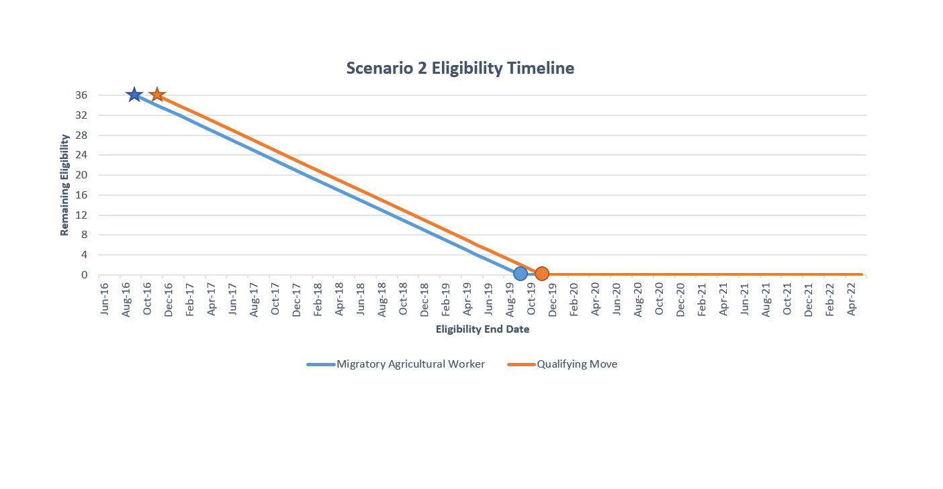
September 1, 2016- Paul’s father becomes a Migratory Agricultural Worker.
September 1, 2019- Paul’s father’s eligibility as a MAW expires.
November 1, 2016- Paul becomes eligible for MEP services after making a Qualifying Move.
November 1, 2019- Paul’s eligibility for MEP services expires.

Slide 28
Scenario 3
Lilia, Huber, and their 3 young children moved together from Oaxaca, Mexico to Elba, NY on August 1, 2015. Soon after the move (within 2 weeks) both Lilia and Huber obtained work packing onions. After the packing season ended on February 10, 2016, the family moved together to Cortland, NY, where Huber obtained work at an auto repair shop. The Recruiter identifies the family in Cortland on August 5, 2017.
Are Huber and Lilia’s children eligible for the MEP?

Slide 29
Scenario 3
Are Huber and Lilia’s children eligible for the MEP? Yes
What is the QAD(s)? 8/1/2015 and 2/10/2016
Migratory Agricultural Worker: Is the parent/guardian/spouse or the child himself a Migratory Agricultural Worker? Yes. The children’s parents are Migratory Agricultural Workers because they made a qualifying move in the preceding 36 months, soon after which they engaged in new qualifying work.
Qualifying Move: Did the children make a “Qualifying Move” (Due to economic necessity, from one residence to another, and from one school district to another) within the preceding 36 months? Yes- They made 2 Qualifying Moves
Child: Are the children under the age of 22 and still entitled to a free public education in the state? Yes
With/To Join: Did the children make the Qualifying Move on their own as or with/to join a parent/guardian/spouse who is a Migratory Agricultural Worker? Yes

Slide 30
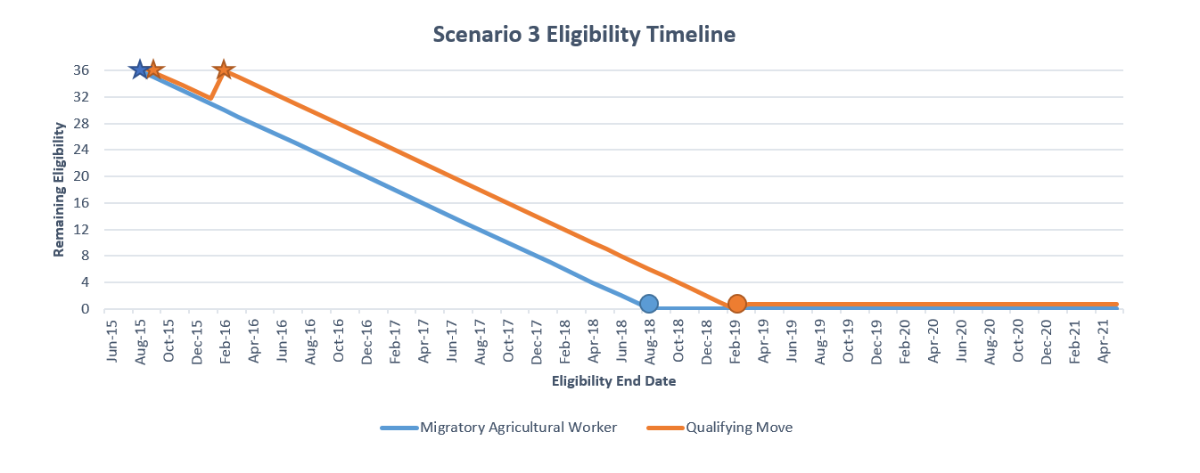
August 1, 2015- Lilia and Huber become Migratory Agricultural Workers.
August 1, 2015- The 3 children become eligible for MEP services after making a Qualifying Move.
February 10, 2016- The 3 children make another Qualifying Move and their 36 month MEP eligibility resets.
August 1, 2018- Lilia and Huber’s eligibility as Migratory Agricultural Workers expires.
February 10, 2019- The children’s eligibility for the MEP expires.

Slide 31
Scenario 4
Julio, a 17-year old Out-of-School Youth, had not moved since he was about 10 years old. Because he could not find employment in his hometown of Olean, NY, he moved to Sodus, NY on July 1, 2017. Within a week of moving to Sodus, he applied for seasonal employment picking apples, but did not get the job.
Is Julio eligible for the MEP?

Slide 32
Scenario 4
Is Julio eligible for the MEP? No
Migratory Agricultural Worker: Is the parent/guardian/spouse or the child himself a Migratory Agricultural Worker? No. He did not engage in new qualifying work soon after the move. Although he actively sought new qualifying work after the move, he does not have a recent history of moves where he engaged in qualifying work.
Qualifying Move: Did the children make a “Qualifying Move” (Due to economic necessity, from one residence to another, and from one school district to another) within the preceding 36 months? Yes
Child: Are the children under the age of 22 and still entitled for a free public education in the state? Yes
With/To Join: Did the children make the Qualifying Move on their own as or with/to join a parent/guardian/spouse who is a Migratory Agricultural Worker? No- Although he made a move in the preceding 36 months it was not as a/with a MAW.

