Slide 1

New Recruiter Training:
Completing the ECOE
NYS Migrant Education- Identification and Recruitment

Slide 2
The Electronic COE
In New York State we use the National COE, and our recruiters use tablets to fill out Electronic COEs. Each COE consists of the following sections:
Heading
Census Data
Child(ren) Data
Qualifying Moves and Work Data
Signatures
Eligibility Comments

Slide 3
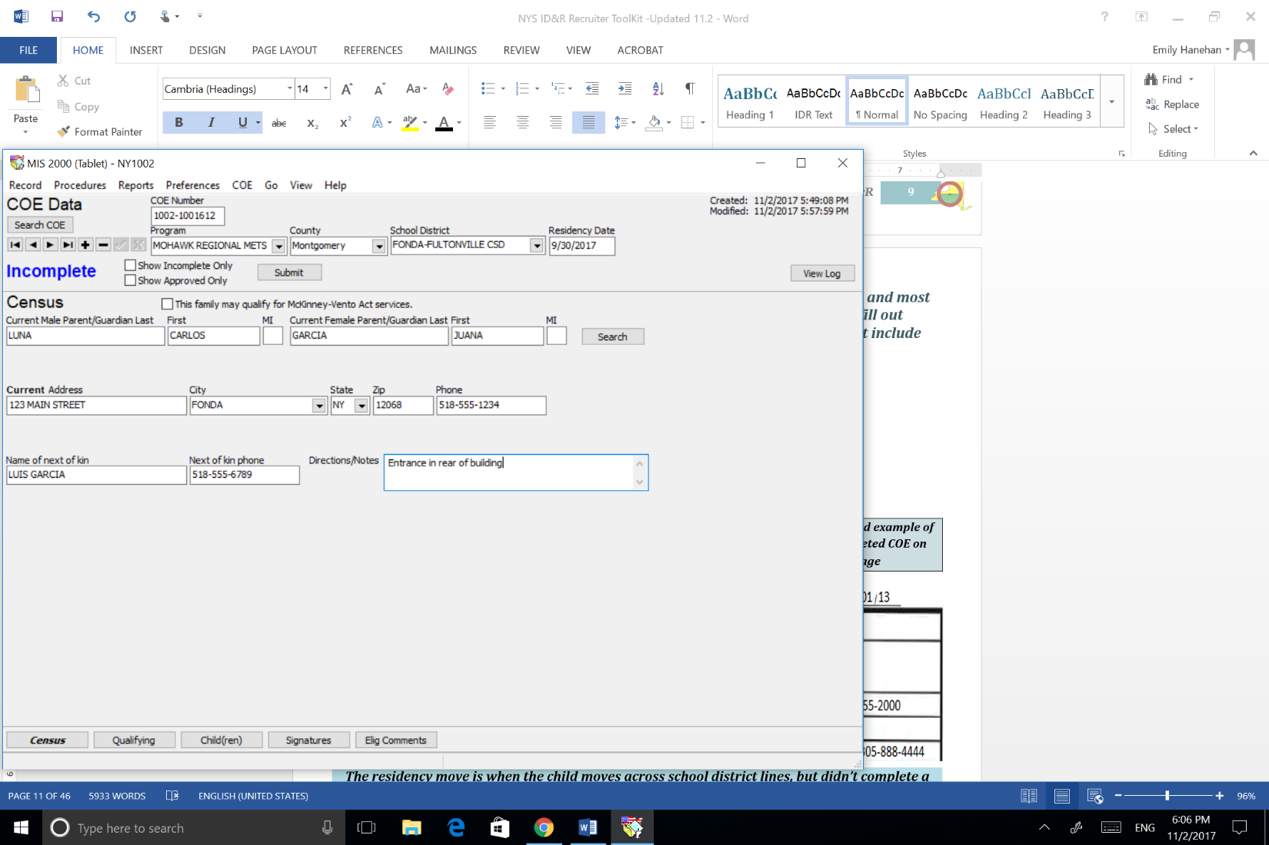
Heading
Fill out the Heading section with the following information:
Program/METS
County
School District
Residency Date- The date that the child entered the current school district.

Slide 4
Census Data
List the names of the child’s current parents or guardians.
If the student is an OSY leave the parent section blank.
Fill in current address and other contact information.
Complete each field, as applicable.
If a response is not required or does not apply, leave blank.
Tip: A Residency Move is when a currently eligible child moves across school district lines, but didn’t complete a Qualifying Move with a Migratory Agricultural Worker. In this case the recruiter will update the Census Data, and issue a new Residency Date. The Qualifying Section will remain the same.

Slide 5
Census Data

Slide 6
Child Data
Complete a separate COE for any child with different current family info or different eligibility info (including a different QAD).
To answer the Multiple Birth Question (MB) write (N) for No and (Y) for Yes. Answer yes if there are multiple children on the COE born on the same date (twins, triplets, etc.)
To complete the Birth Date Verification Code: Record the four number code that corresponds to the evidence used to confirm each child’s birth date. If written evidence is not available, the recruiter may rely on a parent or emancipated youth’s verbal statement. In such cases, you should record “1007” – the number that corresponds to “parent’s affidavit.”
Notes:
“

Slide 7
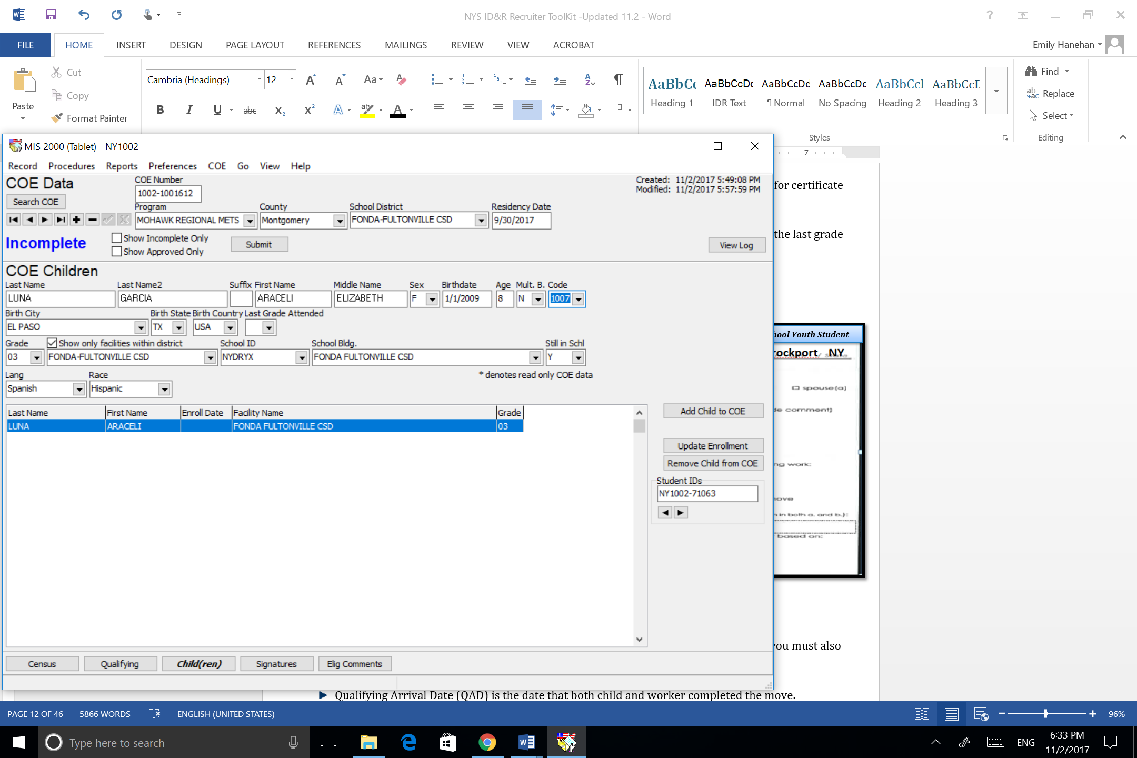
Child Data

Slide 8
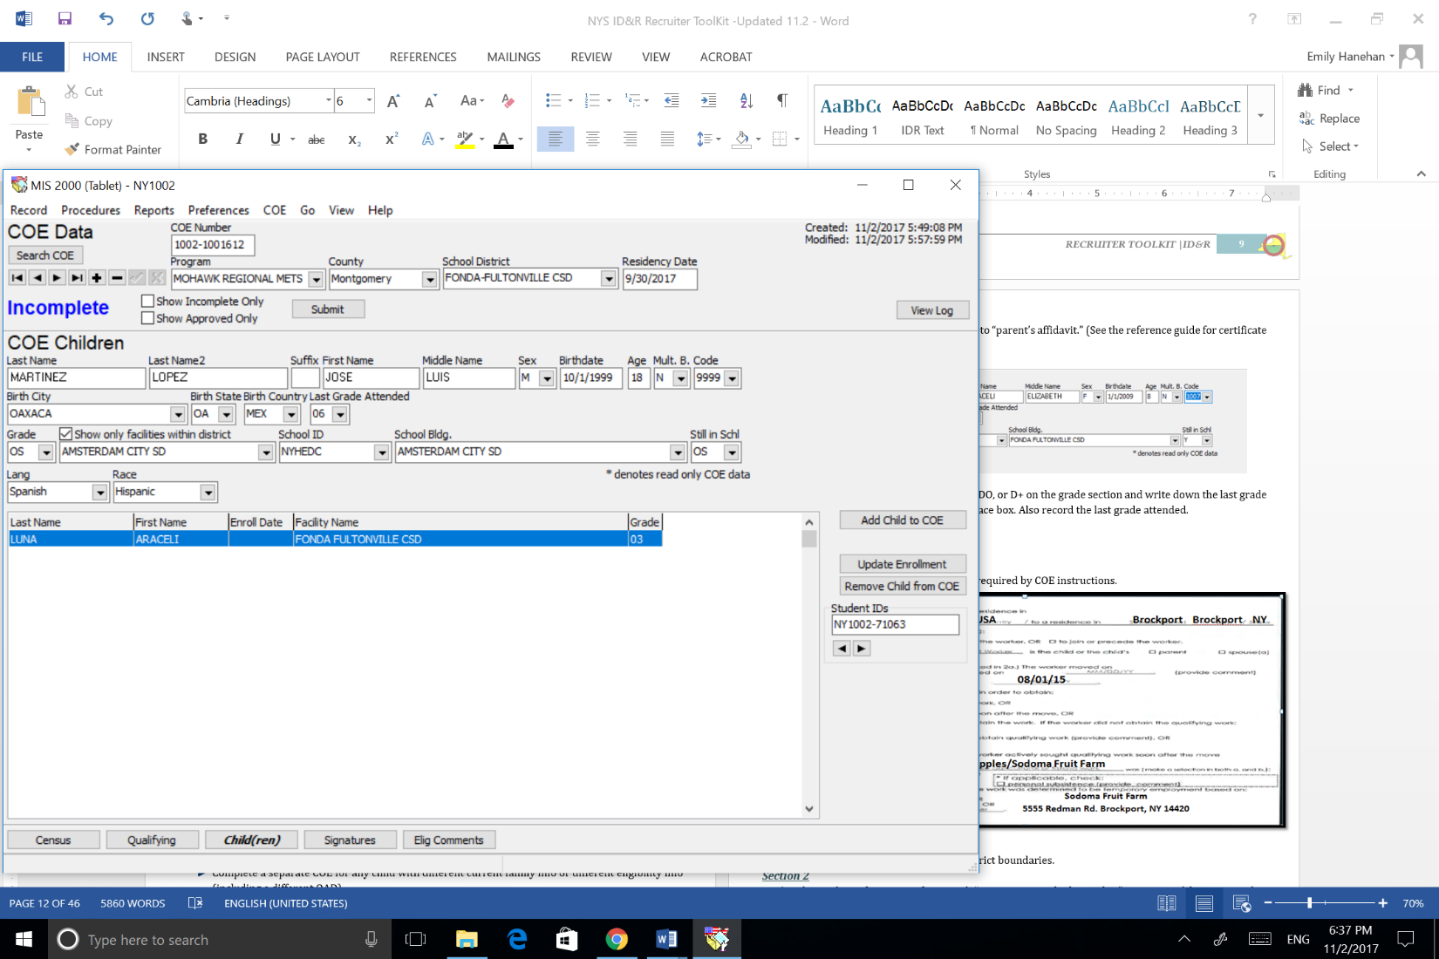
Child Data
Tip: If the student is an OSY write code OS, DO, or D+ in the grade section. Also record the last grade attended.

Slide 9
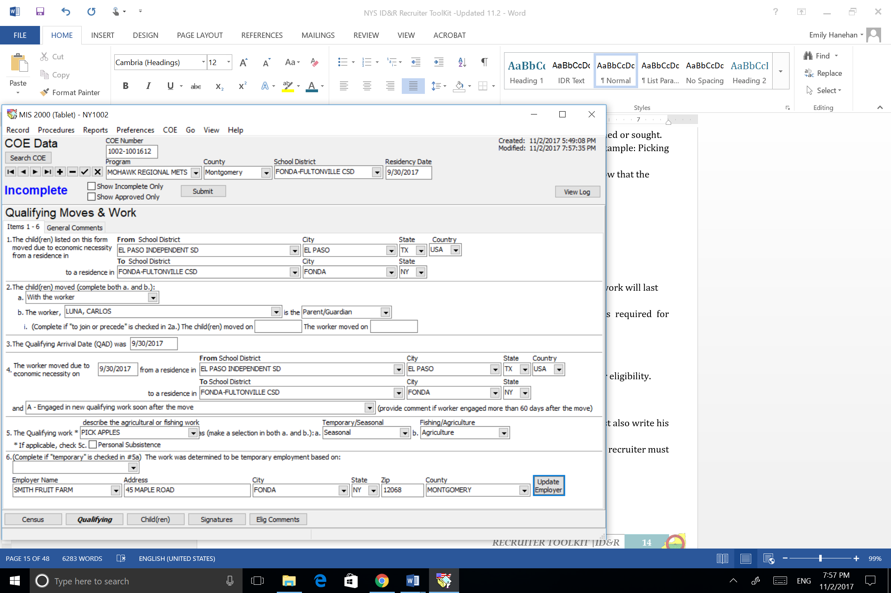
Qualifying Moves and Work Data
Section 1
Document the Qualifying Move across school district boundaries.
Notes:
“

Slide 10
Qualifying Moves and Work Data
Section 2
The Child/Migratory Agricultural Worker move information. Mark if the child moved as the worker, with, or to join or precede the Migratory Agricultural Worker. If you mark “to join or precede the worker” in section 2a, you must also complete section 2bi and provide a comment in the “Eligibility Comments” data section.
Notes:
“

Slide 11
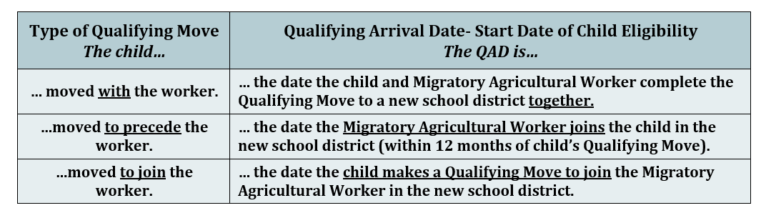
Qualifying Moves and Work Data
Section 3
The Qualifying Arrival Date (QAD) is the date that both the child and the Migratory Agricultural Worker completed the Qualifying Move.
Notes:
“

Slide 12
Qualifying Moves and Work Data
Section 4
Describe the Qualifying Move the worker made in order to become a Migratory Agricultural Worker.
Include the date the Migratory Agricultural Worker completed the Qualifying Move, and where he moved to/from.
If the worker engaged in qualifying work soon after the move (within 60 days) mark 4a.
Notes:
“

Slide 13
Qualifying Moves and Work Data
Section 4
If the worker did not engage in qualifying work soon after the move, mark 4b if the following conditions are met:
  - The worker actively sought new qualifying work, AND
  - Has a recent history of moves for new qualifying work (2 moves in the past 36 months).
If you mark 4b, or if you mark 4a and the worker engaged in qualifying work more than 60 days after the move, provide a comment in the “Eligibility Comments” data section.
Notes:
“

Slide 14
Qualifying Moves and Work Data
Section 5
Describe the agriculture or fishing work the Migratory Agricultural Worker performed or sought.
Include the worker’s action (verb) and the agriculture or fishing product (noun). Example: Picking apples, milking cows, cutting chicken, etc.
  Include enough information so that a third party can look at the COE and know that the worker is engaged in agricultural work.
Choose if the work was temporary or seasonal, and agriculture or fishing.
Notes:
“

Slide 15
Qualifying Moves and Work Data
Section 6
If you selected temporary employment in Section 5a:
Mark if you determined the work was temporary based on:
  - 6a: Worker’s statement or a statement by a member of the worker’s family.
  - 6b: Employer statement or documentation provided by employer.
Mark the amount of time (less than 12 months) the worker or employer states the work will last based on the options listed in the “Eligibility Comments” data section.
Notes:
“

Slide 16
Qualifying Moves and Work Data
Notes:
“

Slide 17
Signature Section
Read the Health and FERPA Statements to the interviewee, or allow the interviewee to read the statements in his/her own language.
The interviewee should sign and date the COE on the day the interview is conducted. Record the interviewee’s relationship to the child.
If the interviewee cannot sign his/her name, he/she must mark an “x” in the signature section.
If the parent refuses to sign, recruiter must document this in the comments section.
Sign the COE immediately after the form is completed.
Notes:
“

Slide 18
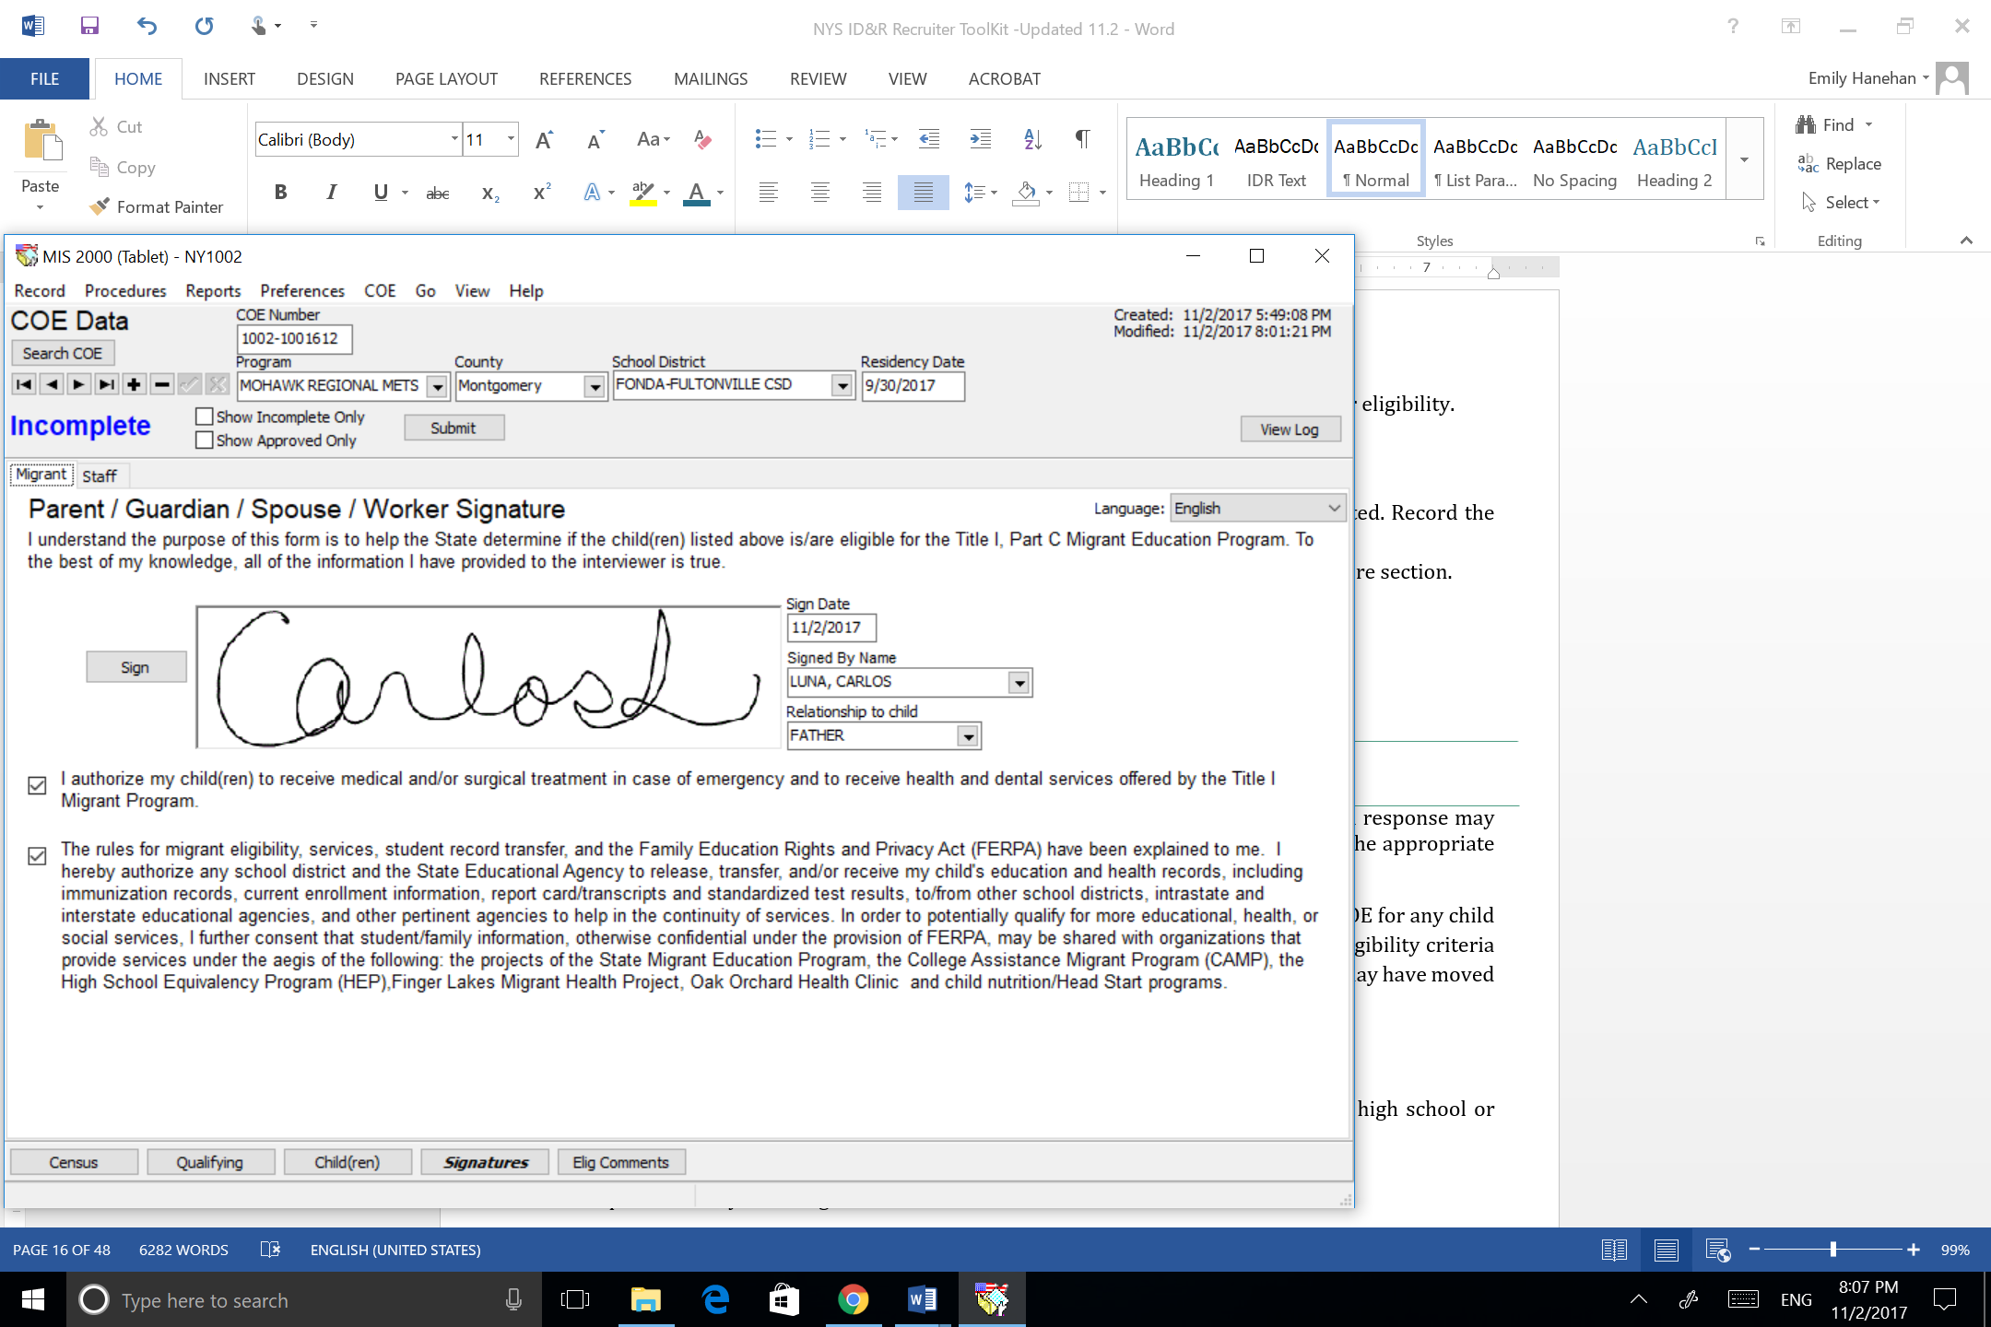
Signature Section
Notes:
“

Slide 19
Eligibility Comments
The recruiter should write clear and detailed comments so an independent party who has no prior knowledge of the eligibility determination can understand the recruiter’s reasoning for determining that the child(ren) is eligible.
The recruiter must provide comments that clearly explain items 2bi, 4a, 4b, 5, 6a and 6b of the Qualifying Move & Work Section, if applicable.
Notes:
“

Slide 20
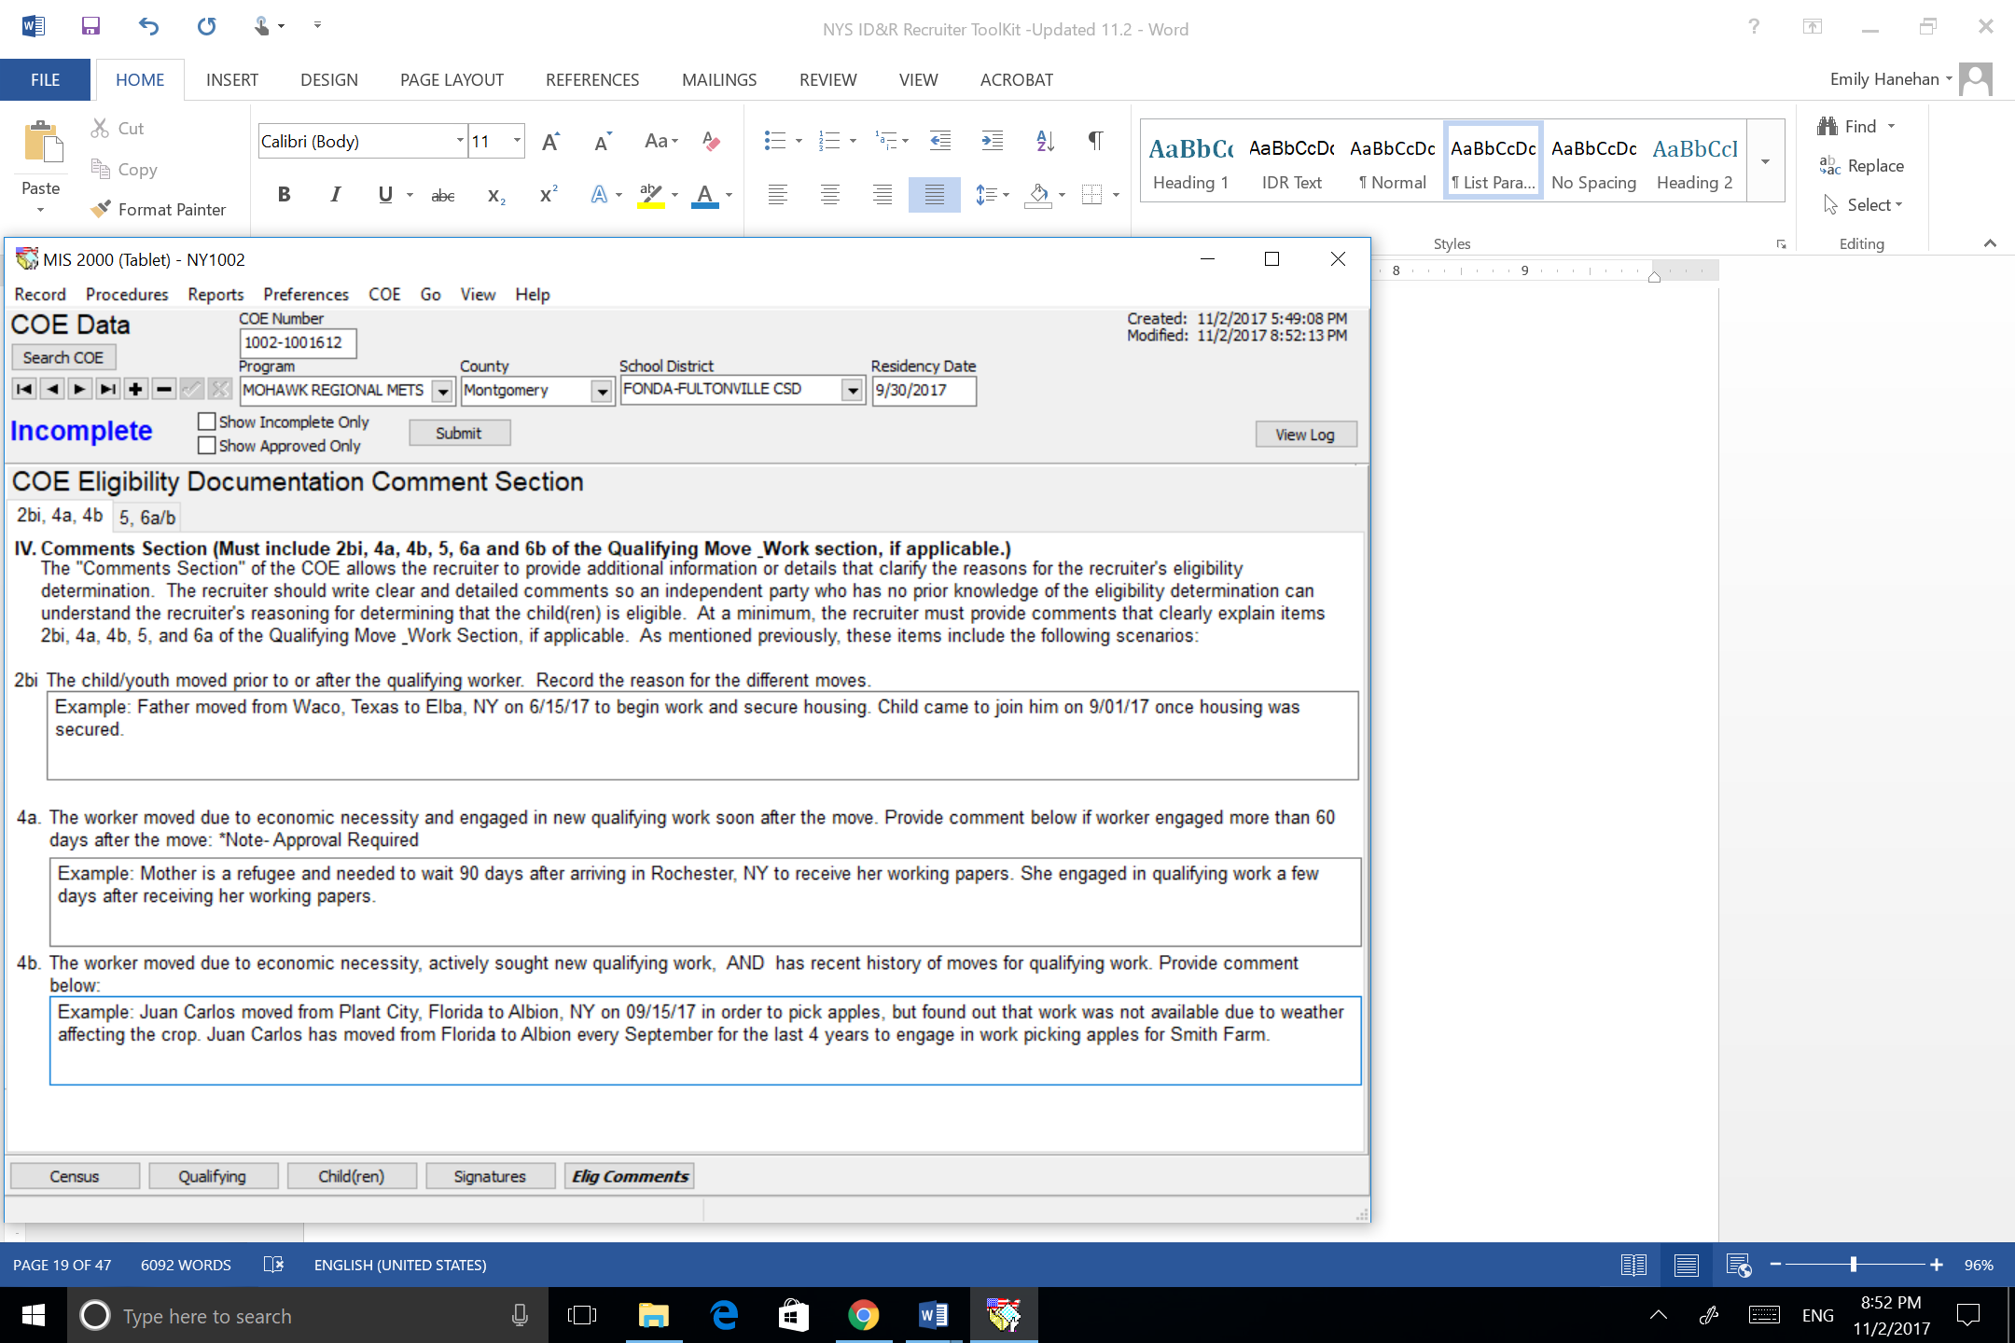
Eligibility Comments
Notes:
“

Slide 21
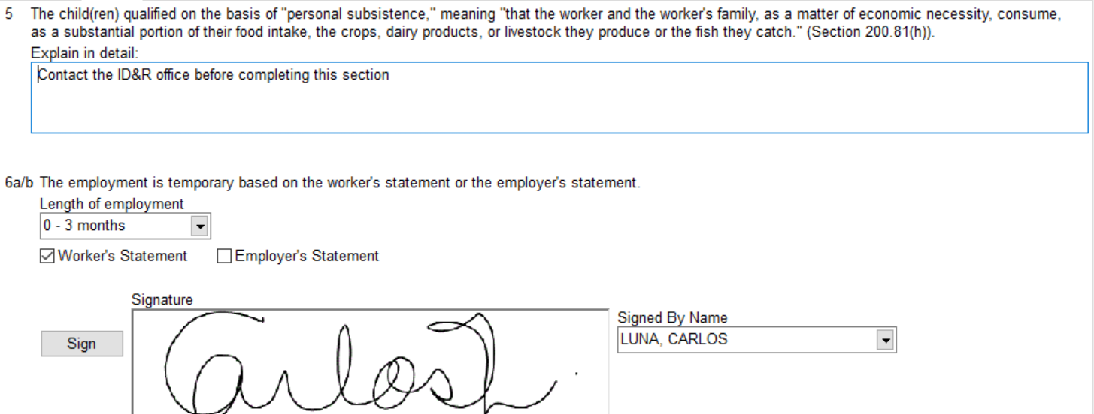
Eligibility Comments
Notes:
“

Slide 22
Keep in Mind
The COE should be submitted within 48 hours of the interview.
Any referrals received from the METS or ID&R offices should be followed up on within 48 hours. Update the referral source on the results of the interview, even if the family or student does not qualify for MEP services.
Contact the ID&R office immediately if you have any questions concerning the eligibility of a child.
Notes:
“

