Slide 1
New Recruiter Training: MSIX: Migrant Student Information Exchange NYS Migrant Education- Identification and Recruitment

Slide 2
Legal Reference
Part C of Title I of the Elementary and Secondary
Education Act (ESEA) of 1965
– Sections 1304(b)(3) and 1308(b).
Statute
34 CFR 200.82(c)
CFR
Non-Regulatory Guidance for Title I, Part C,
Education of Migratory Children
October 2010, VI (D).
NRG

Slide 3
What is MSIX?
Migrant Student Information Exchange (MSIX) is a web-based platform that links States’ migrant student record databases to facilitate the national exchange of migrant students’ educational and health information among the States.
MSIX works in concert with states’ own existing migrant student information systems to fulfill its mission of helping to ensure the appropriate enrollment, placement, and accrual of credits for migrant children nationwide.

Slide 4
MSIX
Produces a single “consolidated record” for each migrant student that contains information from each State in which the student was ever enrolled
Contains the minimum data elements necessary for the proper enrollment, grade and course placement, and accrual of credits for migrant student
Links State migrant systems in a minimally invasive manner to collect, consolidate, and make critical education data available
MSIX does this for the purposes of enrollment, placement, and credit accrual for migrant students.

Slide 5
Privacy Reminder
MSIX contains real, sensitive student data that should not be shared with those who do not need it. MSIX contains the information needed to commit identity theft, so protecting Personally Identifiable Information (PII) is a critical aspect of MSIX. PII is generally considered information that, alone or in combination, is linked or linkable to a specific student that would allow a person, who does not have personal knowledge of the relevant circumstances, to identify the student with reasonable certainty.
If there is a PII incident contact the MSIX Help Desk immediately.
Please be aware of sensitive data and PII when sending screenshots within your department or troubleshooting with the Help Desk.

Slide 6
How MSIX Can Help
Search for students to determine if they have been in the Migrant Education Program (MEP)
View a new student’s Course History to determine course and grade level placement
Look for a Limited English Proficient (LEP) flag, which may be an indication that a language assessment should be administered
Flagged students that are potential duplicates
See if a student has an Individualized Education Plan (IEP) flag so you can request the IEP from the previous school
View the Historical Record to review a student’s educational and migrant history
Determine how many credits a student has accrued toward graduation
Send notification about student’s arrival or departure
Allows states to improve accuracy of information

Slide 7
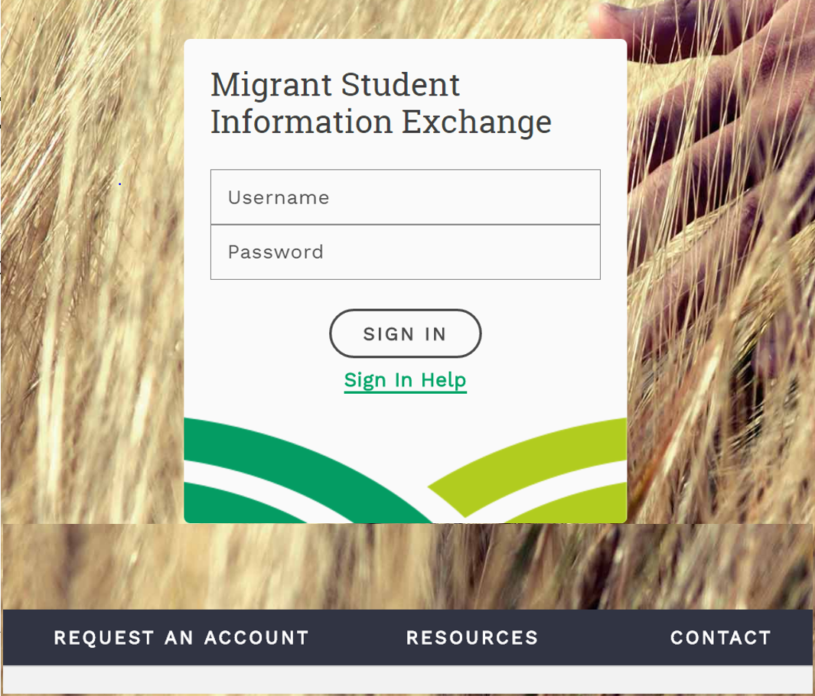
msix.ed.gov

Slide 8
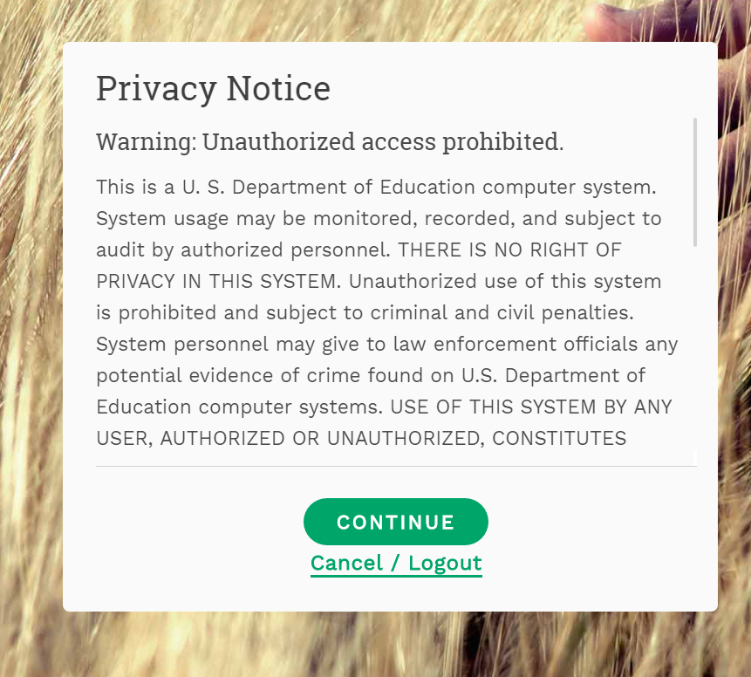
msix.ed.gov

Slide 9
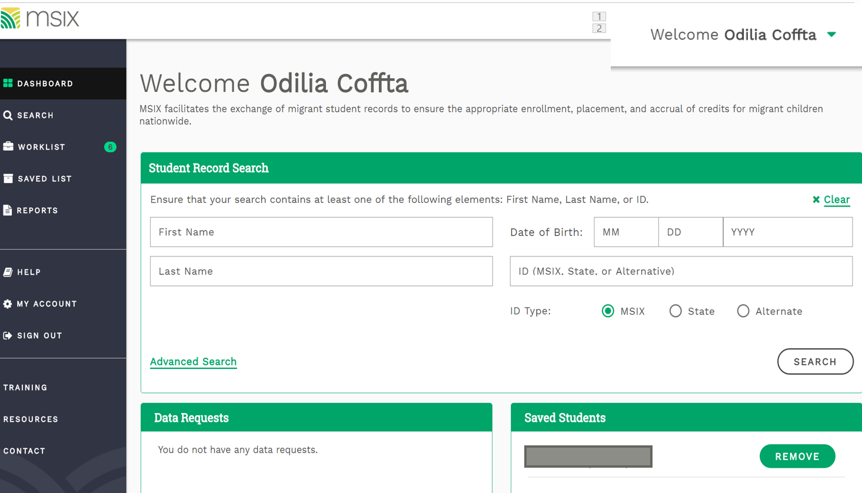

Slide 10
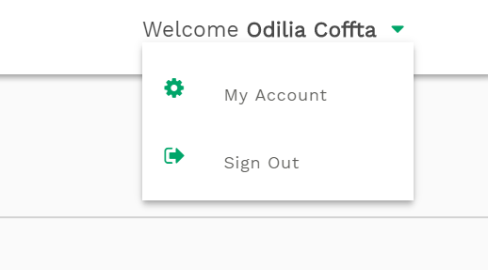
Reviewing Your Account Information

Slide 11
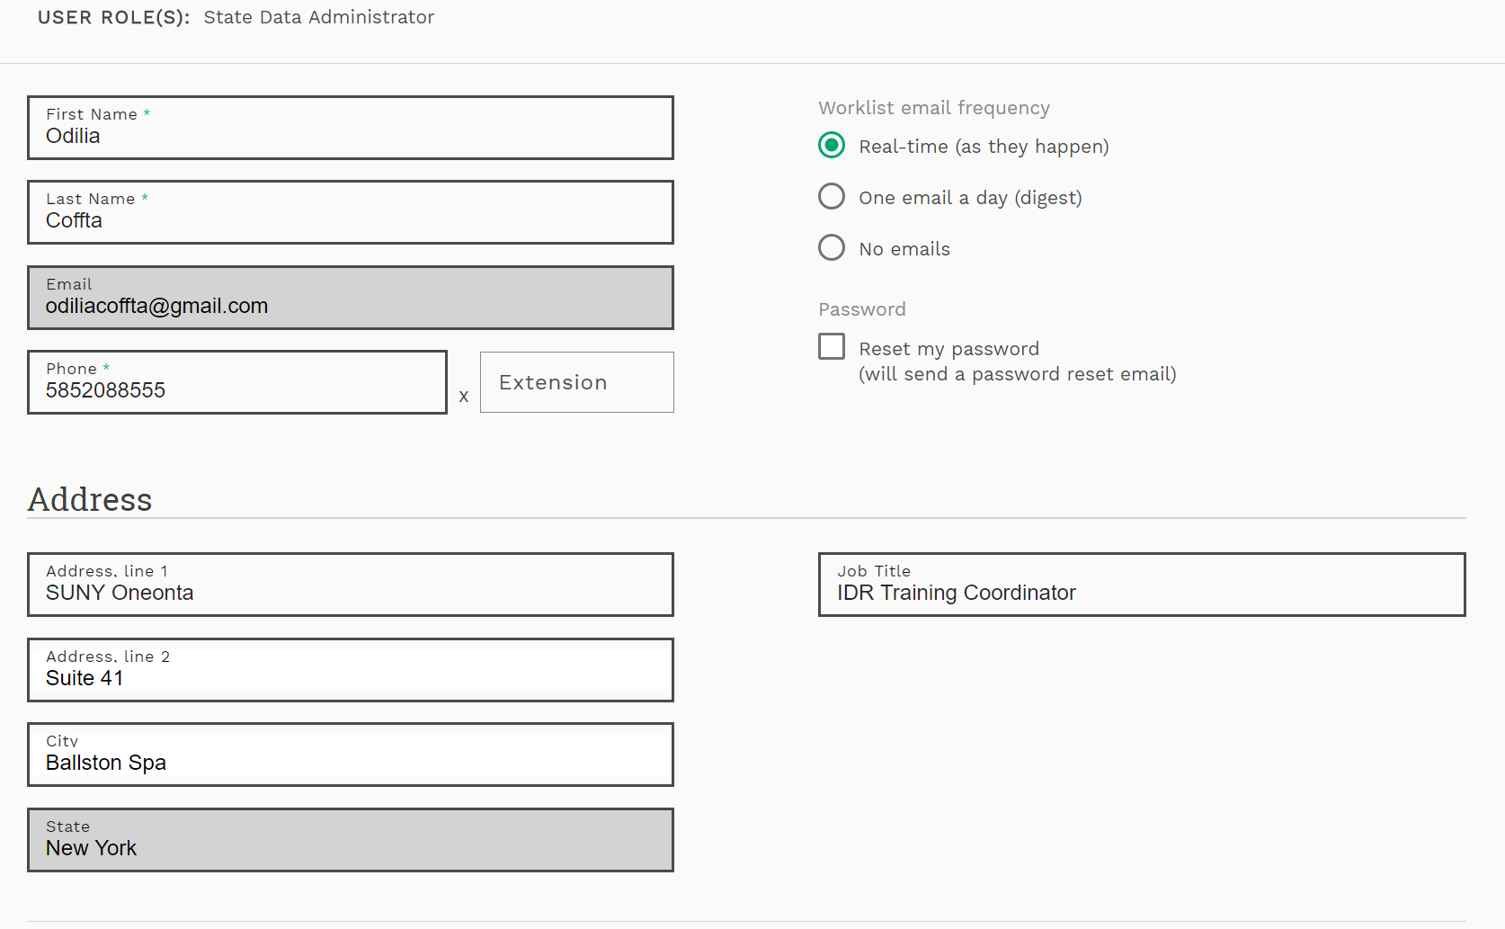

Slide 12
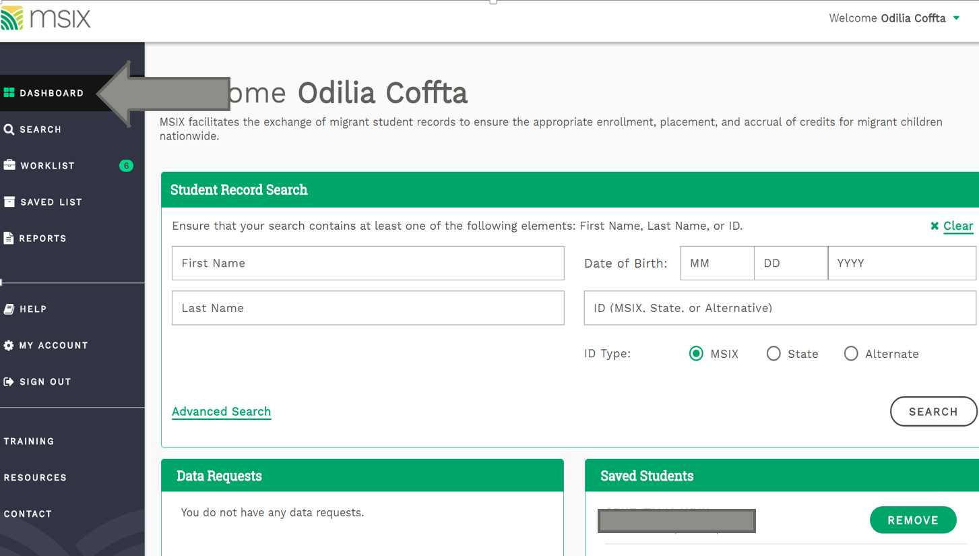

Slide 13
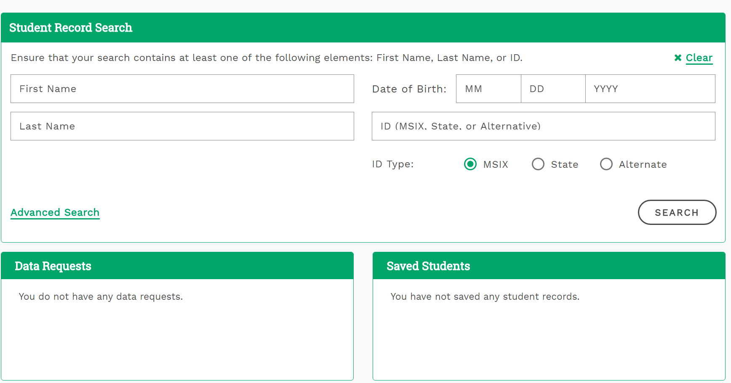
Dashboard

Slide 14
Student Search

Slide 15
Dashboard

Slide 16
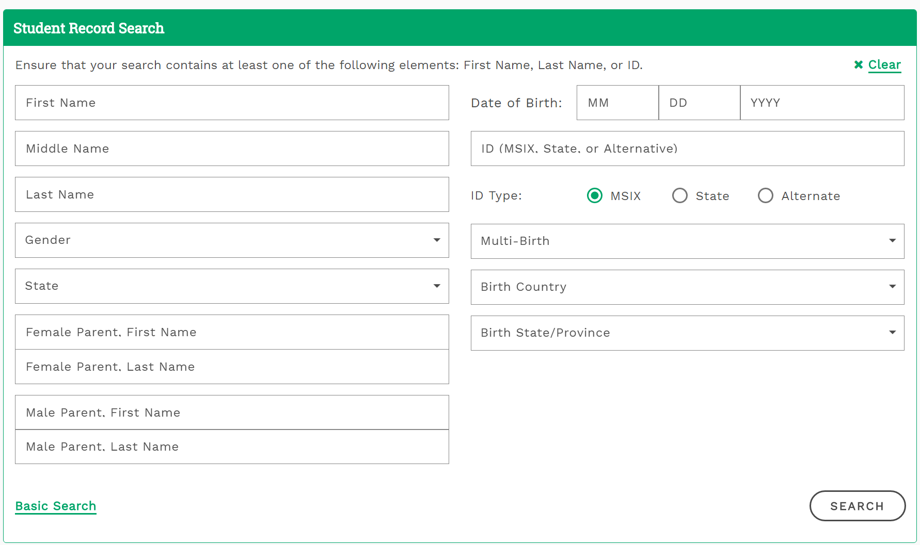

Slide 17
MSIX Student Data
Student Data
Demographics
Course History
Assessments
Enrollments

Slide 18
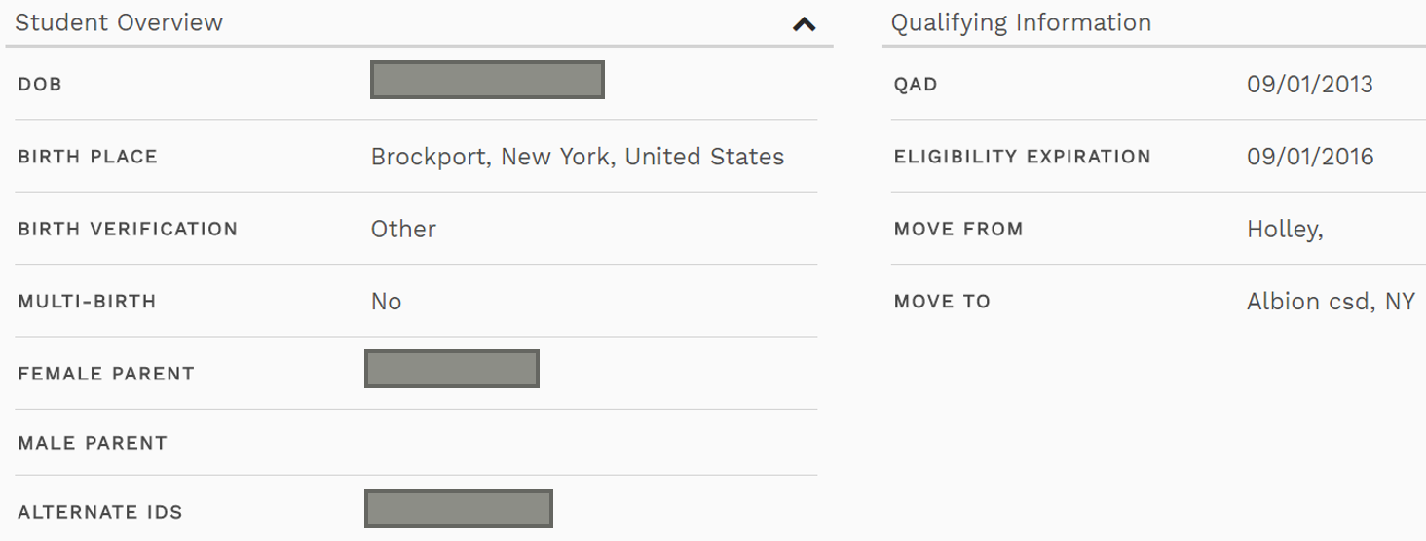
Demographics

Slide 19
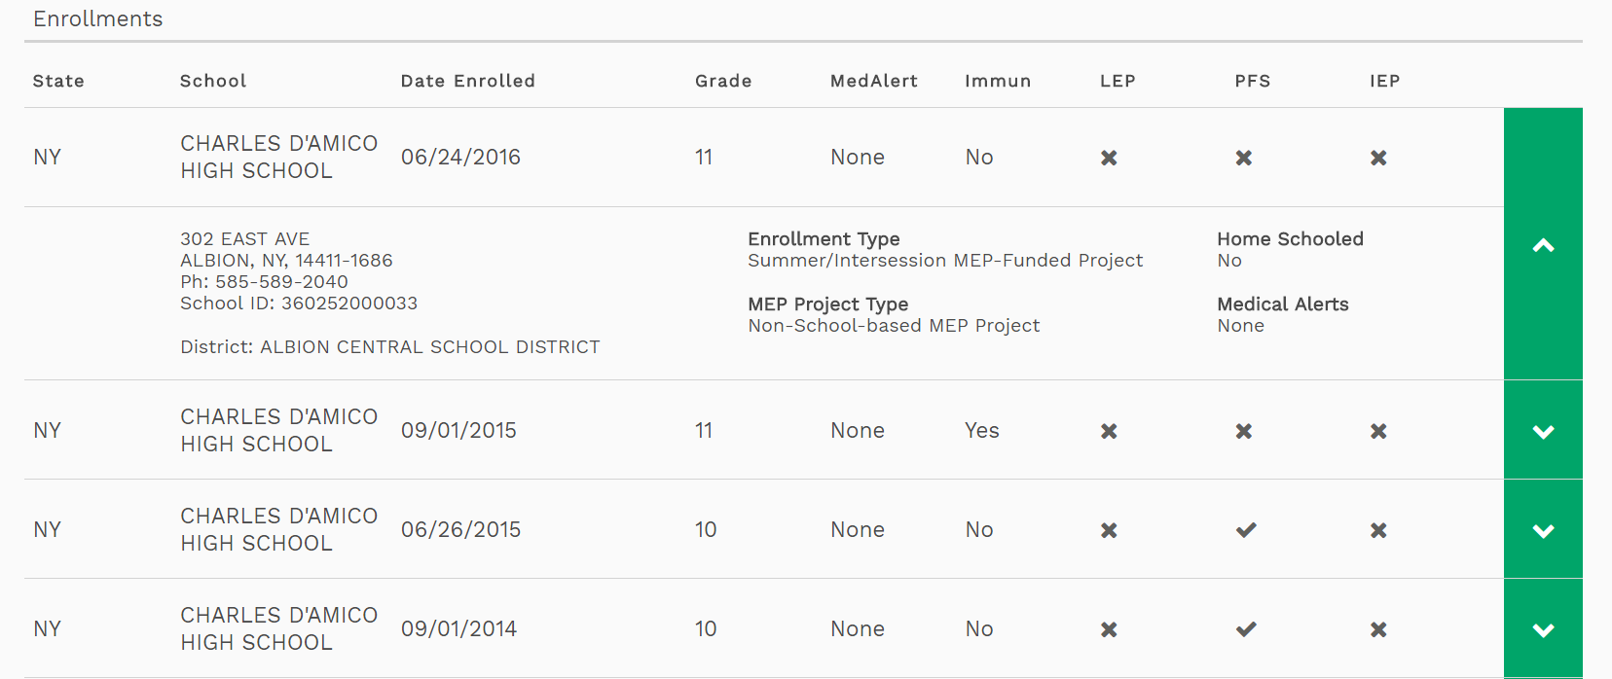
Enrollments

Slide 20
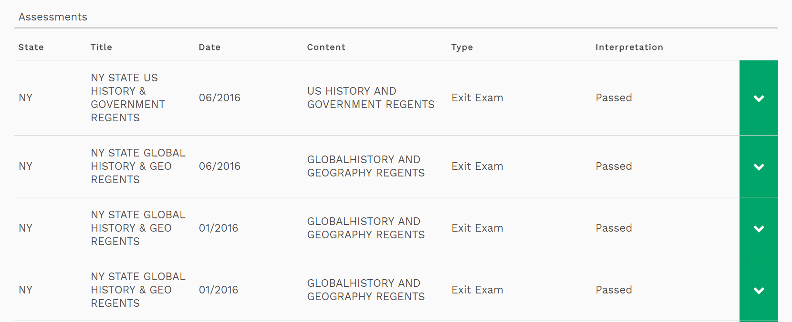
Assessments

Slide 21
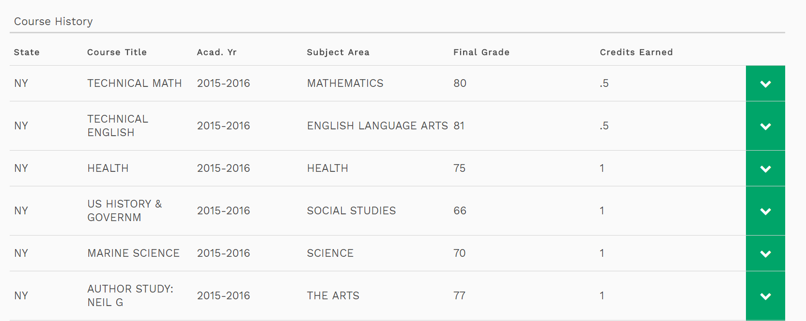
Course History

Slide 22
If you need an account:
Download the MSIX User Access Guide and Application and complete the User Access Application here: https://msix.ed.gov/msix/#/requestAccount
Submit your application to Will Messier, ID&R/MIS2000/MSIX Director
Will Messier reviews and approves the form, then creates a new account.
Call or email Will Messier: 518-289-5618 (phone) 518-265-0206 (cell)
wmessier@nycap.rr.com
If you need to reset your password:

