Slide 1

D A T A S E C U R I T Y
ANNUAL EMPLOYEE TRAINING

Slide 2
REVIEW
WHAT IS PERSONALLY IDENTIFIABLE INFORMATION?

Slide 3
Personally Identifiable Information (PII)
Personally Identifiable Information can be any information about an individual that can be used on its own or with other information to uniquely identify, contact, or locate them
As an MEP employee or contractor, you are responsible for protecting any data that you have collected

Slide 4
Examples of PII
Combining pieces of PII data could result in a set of information that is uniquely identifiable
Sensitive PII
Social Security
Drivers License
Passport Number
Educational Records
Medical Records
PII
Full Name
Email Address
Home Address
Date of Birth
Employer

Slide 5
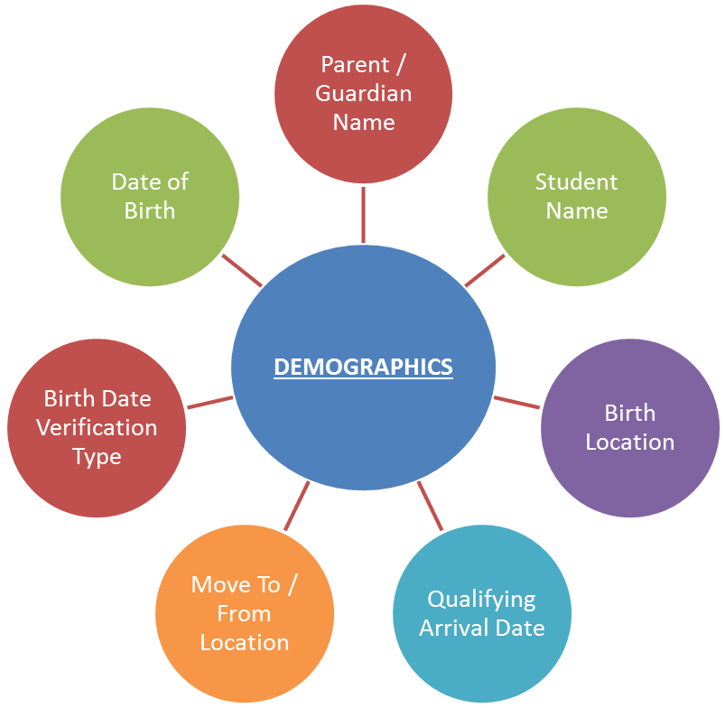
Migrant Student Data
Migrant student information collected through the Certificate of Eligibility (COE) includes Sensitive PII
Academic records associated with a migrant student are considered Sensitive PII

Slide 6
Principle of Least Privilege
This is the principle of granting the least amount of access necessary to perform one’s job duties. Following the Principle of Least Privilege better safeguards the system data against possible compromise. In New York, student data is only granted to the employees who work with those students

Slide 7
Family Educational Rights and Privacy Act (FERPA)
Passed in 1974
Allows students to request their own records from schools
Protects the disclosure of student PII and educational records without consent
Exempts certain institutions from release consent requirements

Slide 8
FERPA Exceptions
School officials with legitimate educational interest
Other schools to which a student is transferring
Specified officials for audit or evaluation purposes
Appropriate parties in connection with financial aid to a student
Organizations conducting certain studies for, or on behalf of, the school
Source: https://www2.ed.gov/policy/gen/guid/fpco/ferpa/index.html

Slide 9
FERPA Exceptions (continued)
Accrediting organizations
To comply with a judicial order or lawfully issued subpoena
Appropriate officials in cases of health and safety emergencies
State and local authorities within a juvenile justice system pursuant to specific state law
Source: https://www2.ed.gov/policy/gen/guid/fpco/ferpa/index.html

Slide 10
Parent’s Bill of Rights
NYSED has required a “parent’s bill of rights” to explain what privileges parents have to access their children’s data.
This bill of rights is posted on nysmigrant.org/billofrights
The rights can be summarized as:
  Parent’s have the right to review their child’s education record
  An educational agency must verify the identity of the requesting parent
  These requests must go directly to the educational agency, and not to a third party
  An educational agency must inform the parent of this right annually
  The educational agency must fulfill this request within 45 days
  The records may be sent electronically if the parent requests, as long as they follow proper security requirements

Slide 11
SECURITY TOOLKIT
USERS | DEVICES | INTERNET

Slide 12



The Three “C”s of Security
Secure conduct
Secure computers
Secure communications

Slide 13
Secure Conduct
Thinking secure when interacting with student data
Secure Computers
Ensuring all devices accessing student data are properly secured
Secure Communications
Utilizing secure methods to connect and send data over the internet

Slide 14
Conduct: Thinking Secure
Ensure only FERPA authorized parties have access to protected information
Ensure NYS Migrant Education information is not released without consent

Slide 15
Conduct: Thinking Secure
Request to use two-factor authentication whenever it is available
Never share your account passwords or passphrases with anyone else. Users are responsible for all actions taken with their credentials
Instead of a password, consider using a passphrase
  Passphrases use combinations of words that are easy to remember, but difficult for a computer to guess

Slide 16
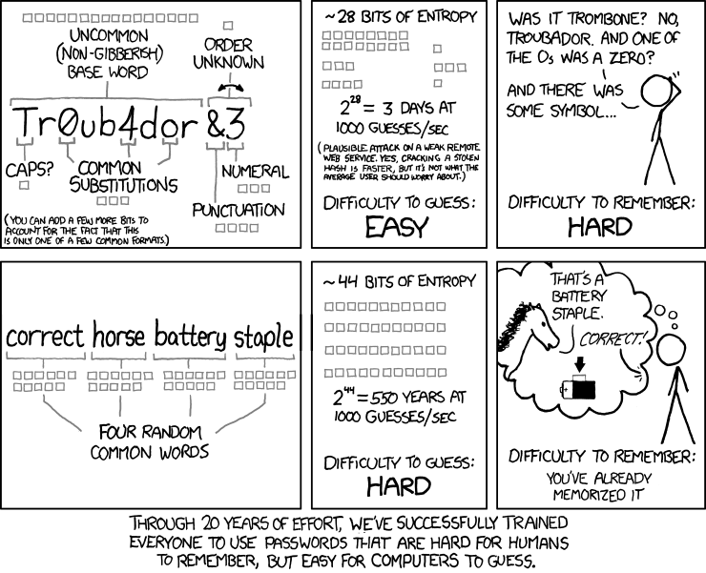
Credit: xkcd

Slide 17
Please give me coffee?

Slide 18
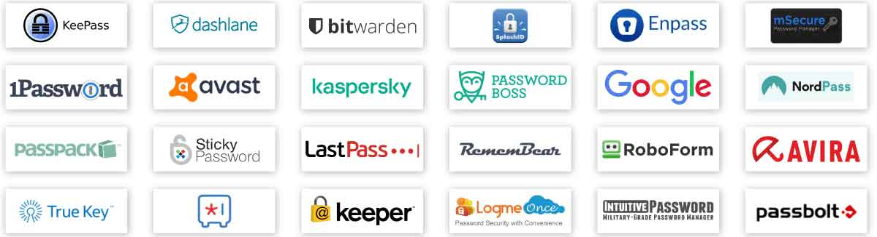
Conduct: Thinking Secure
Consider using a password manager
  These will generate and remember unique passwords for all your accounts
  Reduces the number of passphrases that you need to remember
  Uses one master passphrase that cannot be reset if forgotten

Slide 19
Conduct: Thinking Secure
Be aware of phishing scams
Phishing scam emails attempt to trick you into giving up your password or other private information
Phishing scam emails often try to create a sense of urgency, and inform you that you must act quickly otherwise something bad will happen to you

Slide 20
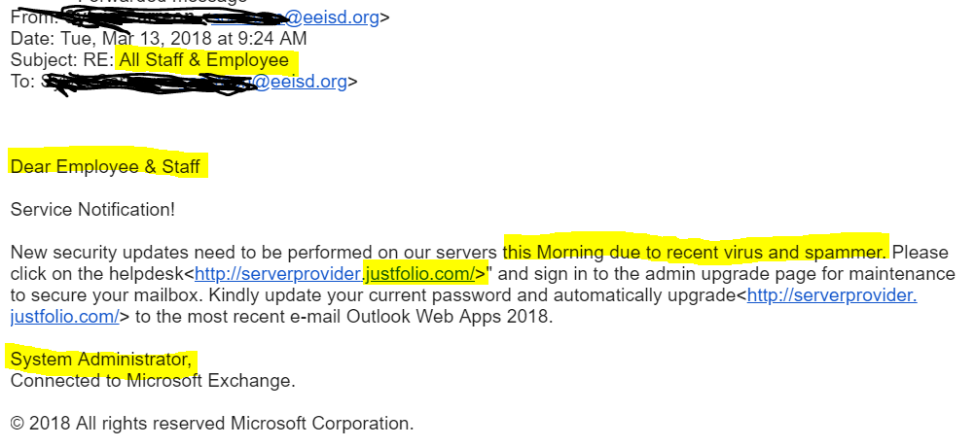
Urgent subject
Generic greeting
Imperfect grammar
Generic signature
Website builder

Slide 21
Conduct: Thinking Secure
Be aware of social engineering scams
  Social engineering phone calls often come unprompted from an individual claiming to represent a large organization, such as Microsoft, who are calling with regards to an issue they have found on your computer
  They will often attempt to direct you to websites that request your credit card number, account information, or access to your computer
  Stop. Think. Ask the representative very simple questions that they would know if they worked for your organization. If they cannot answer, hang up

Slide 22
Computers: Device Security
All devices containing PII should use full disk encryption
  Bitlocker for Windows and for USB drives containing PII
  FileVault for MacOS
All devices used for work should have antivirus installed
Do not leave devices out in a place where they may be stolen, such as an unattended car seat. Instead, store them somewhere out of sight.
Work documents should be securely backed up on a network drive or a cloud platform so they can be restored if destroyed

Slide 23
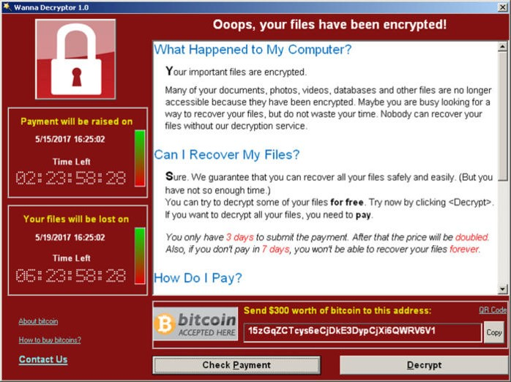
Computers: Device Security
All devices containing PII should use full disk encryption
  Bitlocker for Windows and for USB drives containing PII
  FileVault for MacOS
All devices used for work should have antivirus installed
Do not leave devices out in a place where they may be stolen, such as an unattended car seat. Instead, store them somewhere out of sight.
Work documents should be securely backed up on a network drive or a cloud platform so they can be restored if destroyed

Slide 24
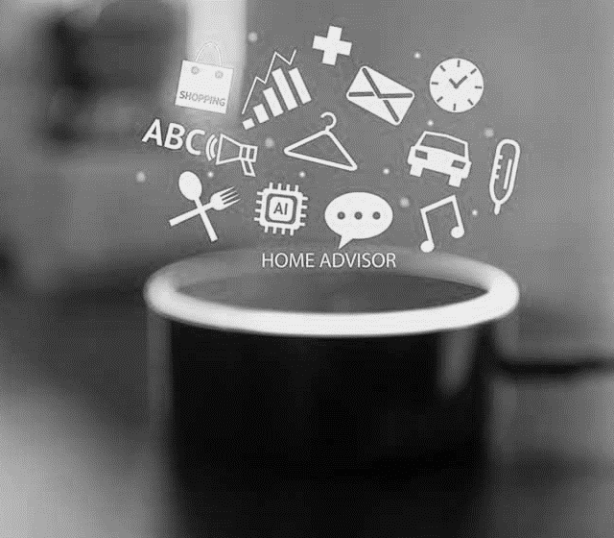
Computers: Device Security
Devices with Smart Assistants such as Siri, Alexa, or the Google Assistant, are configured to constantly listen for commands. It is best practice to use the “mute” feature on any of these devices while at work, particularly when any Personally Identifiable Information is being discussed.

Slide 25
Communications: Internet Security
When connecting to public WiFi network, use a VPN if available or a mobile hotspot instead
PII must never be placed in the body of an email; instead, it must be sent as an encrypted attachment if no better alternative to email is possible
The password for an encrypted attachment must be sent through a different form of communication (separation of mediums)
  Phone call
  Text
  Previously known password

Slide 26
Communications: Internet Security
Common file encryption programs include:
  Microsoft Office: Encrypt Office files
  Adobe Acrobat Pro: Encrypt PDF files
  7zip: Compress & encrypt files
  NAPS2: Scan documents directly to an encrypted PDF file

Slide 27
Communications: Internet Security
Email accounts must be owned and administered directly by the NYSMEP or a sponsoring institution.
The NYSMEP or the sponsoring institution must be able to monitor actions performed by these accounts, audit communications sent and received by these accounts, and regulate access controls to these accounts. They must be able to suspend access to these accounts on demand without participation by the end user. See page 4 of the policy book for more information.
Personal email accounts (gmail.com, yahoo.com, etc) may not be used for work.

Slide 28
QUESTION
“Can I just send the password in a second email?”
NO

Slide 29
Communications: Internet Security
Discuss: what if I do not have another way to contact the individual?
Include a confidentiality notice at the bottom of emails containing such attachments or information

Slide 30
Confidentiality Notice
"This electronic message is intended to be for the use only of the named recipient, and may contain information from the [organization] that is confidential or privileged, or protected FERPA. If you are not the intended recipient, you are hereby notified that any disclosure, copying, distribution or use of the contents of this message is strictly prohibited. If you have received this message in error or are not the named recipient, please notify us immediately, either by contacting the sender at the electronic mail address noted above or calling the [organization] at [phone number], and delete and destroy all copies of this message. Thank you"

Slide 31
BREACH OF DATA
RISKS | CAUSES | REPORTING

Slide 32
Risks of improper handling
Risks to Migrant Children and Families
Identity theft, financial loss, and/or credit damage
Emotional distress
Loss of confidence in the government
Risks to MEP Employees
Disciplinary action resulting in: loss of clearance, loss of access to PII, or loss of employment
Penalties under the Family Educational Rights and Privacy Act Privacy Act
Diminished reputation
Risks to the MEP
Diminished reputation
Costs of mitigation and/or litigation
Impact on agency processes
Loss of the public trust

Slide 33
Causes
Can be a simple mistake, such as sending an email with PII to the wrong recipient
Can be the result of a compromised account or device
Theft of device
Lack of encryption
Many more
Better safe than sorry- report any warning signs

Slide 34
Reporting
Step 1: Contain the breach
Step 2: Contact immediate supervisor
Step 3: Contact the ID&R / MIS2000 Director
Step 4: Document the breach
On many occasions, the ID&R / MIS2000 Director might request that you participate in a detailed evaluation of the events leading to the breach for official records, prevention, and other uses
Notes:
+ Kin Chee

Slide 35
ENCRYPTION TOOLS
MICROSOFT OFFICE | 7-ZIP

Slide 36

Microsoft Office
Add a password to any Office file with this built-in encryption utility

Slide 37

7-zip
Encrypt any file, not just .PDFs!

Slide 38

Online Guide
All encryption steps can be found online for future reference at www.nysmigrant.org/encryption

Slide 39
What can you do right now?
Turn on multifactor authentication for all your accounts
Start using a passphrase for your next account
Find a password manager that is right for you
See if a VPN is available to you through your organization

Slide 40
Questions?
THANK YOU FOR ATTENDING!

