Slide 1
Basic Oral Language Screening Tool (BOLST)
New York State Migrant Education Program

Slide 2
Introductions & Greetings
1. Hi, How are you?
2. What is your name?
3. What day is today?

Slide 3
Beginning Literacy Skills
1.What letter is this?

Slide 4
Beginning Literacy Skills
1.What letter is this?

Slide 5
Beginning Literacy Skills
1.What letter is this?

Slide 6
Beginning Literacy Skills
1.What letter is this?

Slide 7
Beginning Literacy Skills
1.What letter is this?

Slide 8
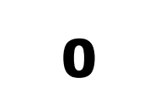
Beginning Literacy Skills
What is this number?

Slide 9
Beginning Literacy Skills
What is this number?

Slide 10
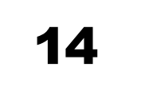
Beginning Literacy Skills
What is this number?

Slide 11
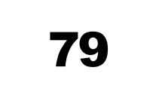
Beginning Literacy Skills
What is this number?

Slide 12
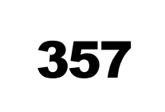
Beginning Literacy Skills
What is this number?

Slide 13
Beginning Literacy Skills
What is this word?

Slide 14
Beginning Literacy Skills
What is this word?

Slide 15
Beginning Literacy Skills
What is this word?

Slide 16
Beginning Literacy Skills
What is this word?

Slide 17
Beginning Literacy Skills
What is this word?

Slide 18
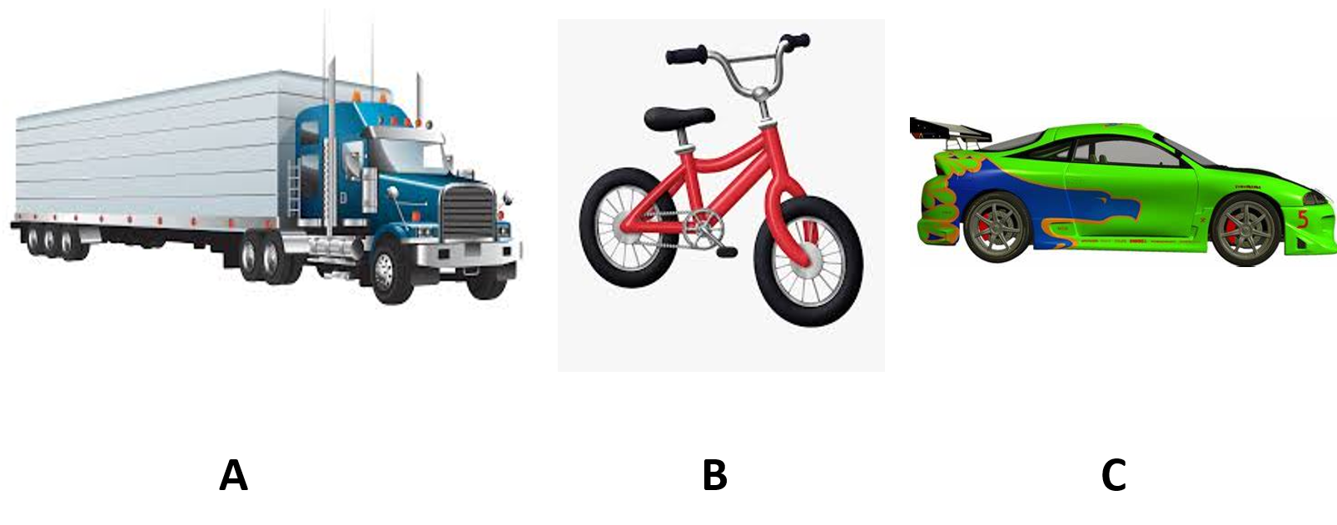
Level 1- Auditory Comprehension

Slide 19
Level 1- Auditory Comprehension

Slide 20
Level 1- Auditory Comprehension

Slide 21
Level 1- Auditory Comprehension

Slide 22
Level 1- Auditory Comprehension

Slide 23
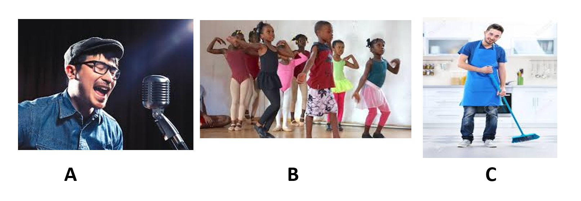
Level 1- Auditory Comprehension

Slide 24
Level II- Ability to Produce Language (Basic Level)

Slide 25
Level II- Ability to Produce Language (Basic Level)

Slide 26
Level II- Ability to Produce Language (Basic Level)

Slide 27
Level II- Ability to Produce Language (Basic Level)

Slide 28
Level II- Ability to Produce Language (Basic Level)

Slide 29
Level II- Ability to Produce Language (Basic Level)

Slide 30
Level III- Ability to Produce Language (Expanded Answers)

Slide 31
Level III- Ability to Produce Language (Expanded Answers)

Slide 32
Level III- Ability to Produce Language (Expanded Answers)

Slide 33
Level III- Ability to Produce Language (Expanded Answers)

