Slide 1
Basic Oral Language Screening Tool (BOLST)
New York State Migrant Education Program

Slide 2


Introductions & Greetings
1. Hi, How are you?
2. What is your name?
3. What day is today?

Slide 3

Beginning Literacy Skills
1.What letter is this?

Slide 4

Beginning Literacy Skills
1.What letter is this?

Slide 5

Beginning Literacy Skills
1.What letter is this?

Slide 6

Beginning Literacy Skills
1.What letter is this?

Slide 7

Beginning Literacy Skills
1.What letter is this?

Slide 8
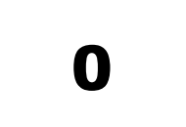
Beginning Literacy Skills
What is this number?

Slide 9

Beginning Literacy Skills
What is this number?

Slide 10
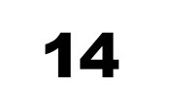
Beginning Literacy Skills
What is this number?

Slide 11
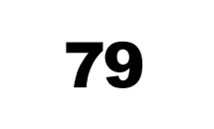
Beginning Literacy Skills
What is this number?

Slide 12
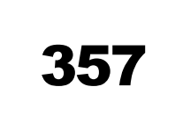
Beginning Literacy Skills
What is this number?

Slide 13

Beginning Literacy Skills
What is this word?

Slide 14

Beginning Literacy Skills
What is this word?

Slide 15

Beginning Literacy Skills
What is this word?

Slide 16

Beginning Literacy Skills
What is this word?

Slide 17

Beginning Literacy Skills
What is this word?

Slide 18
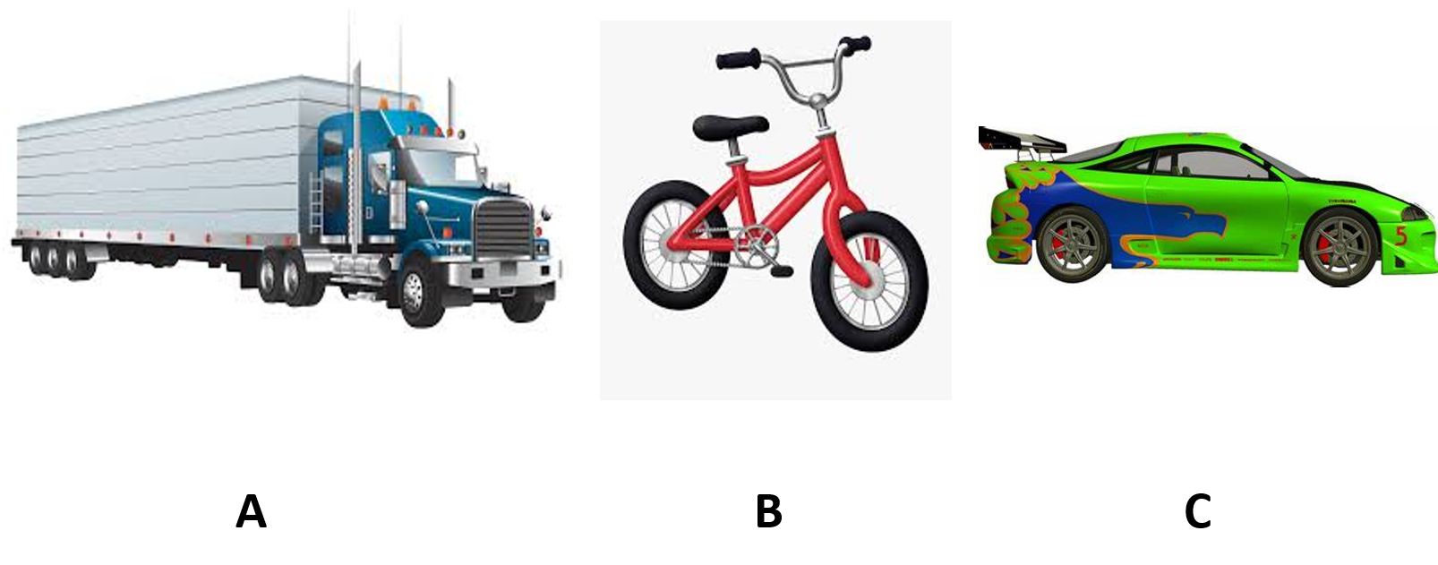
Level 1- Auditory Comprehension

Slide 19
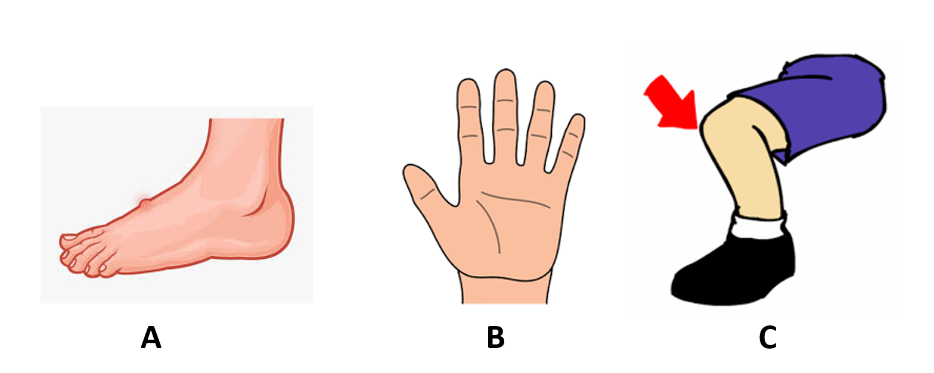
Level 1- Auditory Comprehension

Slide 20
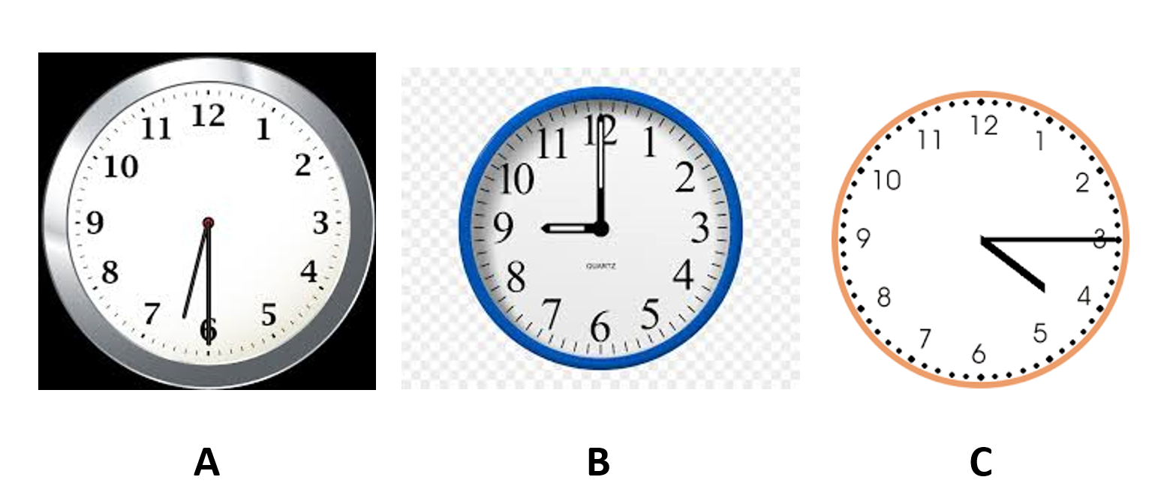
Level 1- Auditory Comprehension

Slide 21
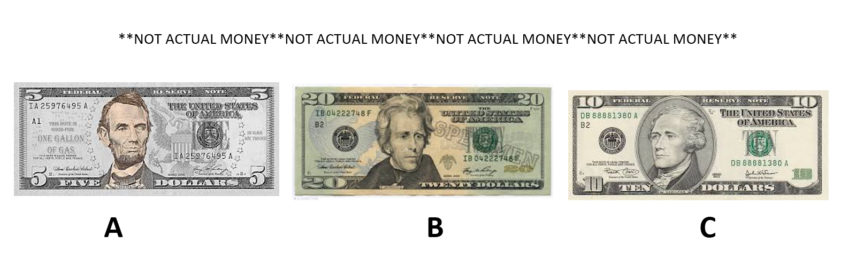
Level 1- Auditory Comprehension

Slide 22
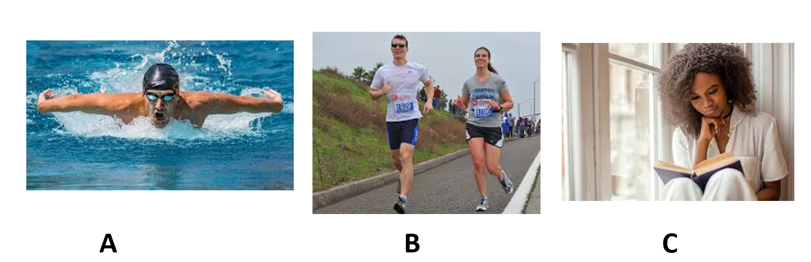
Level 1- Auditory Comprehension

Slide 23
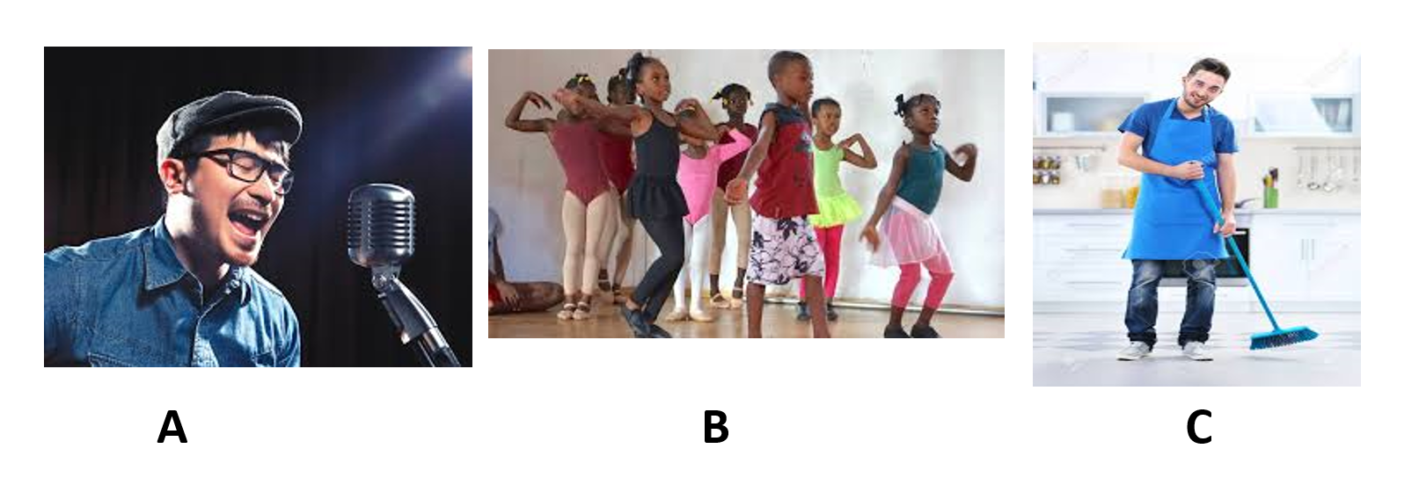
Level 1- Auditory Comprehension

Slide 24
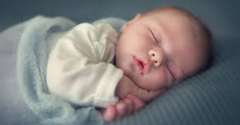
Level II- Ability to Produce Language (Basic Level)

Slide 25
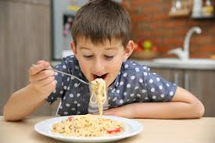
Level II- Ability to Produce Language (Basic Level)

Slide 26
Level II- Ability to Produce Language (Basic Level)

Slide 27
Level II- Ability to Produce Language (Basic Level)

Slide 28
Level II- Ability to Produce Language (Basic Level)

Slide 29
Level II- Ability to Produce Language (Basic Level)

Slide 30
Level III- Ability to Produce Language (Expanded Answers)

Slide 31
Level III- Ability to Produce Language (Expanded Answers)

Slide 32
Level III- Ability to Produce Language (Expanded Answers)

Slide 33
Level III- Ability to Produce Language (Expanded Answers)

