Slide 1
Determining McKinney Vento Eligibility for Migrant Education Students
Presented by NYS TASC on behalf of the Migrant Education Program
Presenter: Erin Allen
January 31st, 2020

Slide 2
Typical Causes of Homelessness
Uncertain Citizenship
Rigorous Work Schedule
Farm Owner Expectations
Cultural Differences
Trafficking
Family Rejection
Mental/Physical Illness
Insufficient Income
Domestic Violence
Natural Disasters
Lack of Affordable Housing
Notes:
These are the common causes of homelessness.
For our families, there are also additional variables that add complexity and/or contribute to a tenuous housing situation:
Uncertain citizenship
Rigorous work schedule and lack of adequate, affordable, accessible childcare while parents are at work
The expectations of the farmer, such as not having children on site and/or living in a crew house
Cultural differences of wanting to live in a multi-family household
Trafficking and/or leveraging young children to gain entry to the U.S.

Slide 3
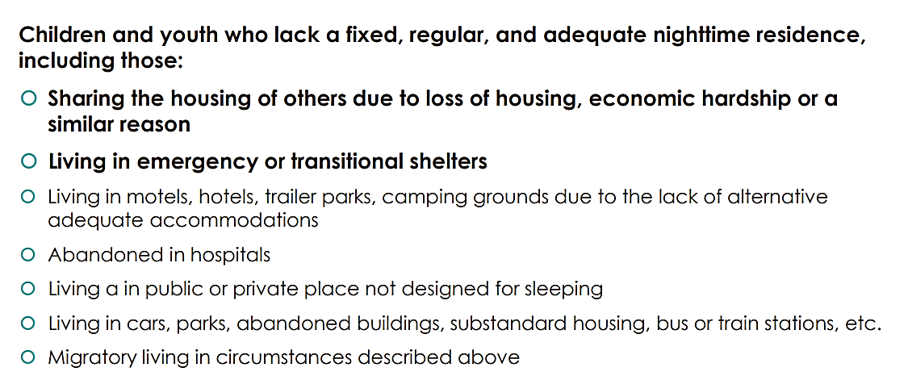
Who is eligible?

Slide 4
What factors determine eligibility?
Fixed (attached to the ground)
Adequate (Heat? Bedroom?)
Regular (Every night? Keys?)
Only families that can answer YES to ALL three questions are permanently housed.

Slide 5
Question #1
If a student is living with a parent/guardian in a home with relatives (e.g. Uncles) can they be considered homeless (doubled-up?)
Notes:
Here, it is critical to consider context and lifestyle. Some families choose to live in multi-family or multi-generational households regardless of economic hardship. Others are sharing homes and living situations primarily because of economic hardship or other challenges (e.g. loss of employment or abusive partners).
Ask about the following questions regarding “Fixed, Regular and Adequate Housing” before making a homeless determination:
• Regular: When did the student and parent/guardian move in with the relatives? Do they sleep there every night?
• Regular: Why are they living there? Are they happy with the current living situation or are they consistently looking for more permanent housing/work?
• Fixed/Adequate: What are the conditions of the living arrangements? Are there enough bathrooms? Does the child have their own room with a door, or are they sleeping on a cot in the living room? Is there adequate heat?
The answers to these questions will reveal if the student is currently in a living situation that is considered homeless doubled-up, or in a stable multi-family household.
Keep in mind that the term “homeless” is loaded. We advise that you discuss “residency” or “living situation” with the family, then share that they may be entitled to additional support because of their current living arrangement.

Slide 6
Question #2
If a student needs to attend work with their parent, because they cannot be left with others in the home, are they considered homeless?
Notes:
Unfortunately, the variable of attending work with the parent, adds complexity to the situation, but is not necessarily part of the information considered when making an eligibility determination.
Please ask more questions about the (1) regularity of the sleeping arrangements and (2) the adequacy of the living arrangements.

Slide 7
Question #3
Is a pre-school aged child living with a babysitter while dad is an hour away considered homeless? How can we support the kindergarten registration process?
Notes:
This student is actually a homeless, unaccompanied youth. Yes! Many unaccompanied youth are young children, not the runaway teen we may think of when we hear the term. My suggestion is that (1) discussions begin with dad over the phone regarding the educational plans in the next year and (2) the tutor begin filling out a medical and education proxy form with the dad (e.g. Power of Attorney agreement signed in front of a notary). This will allow the “babysitter” to make educational and medical choices for the child, including things like pick up and drop off, but does not give her legal guardianship.
Technically, Parent means a parent of a student and includes a natural parent, a guardian, or an individual acting as a parent in the absence of a parent or a guardian (34 CFR § 99.3). However, Power of Attorney provides schools with the additional confidence needed when interacting with the babysitter.
If the dad states that the plan is for the child to move back in with him before school enrollment (here, June/July 2020), I suggest the tutor seek registration in the father’s district of residence. If the plan is for the child to remain with the babysitter, I suggest initiating conversations of best interest determinations as well; these conversations will identify whether it is in the best interest of the child to enroll in the father’s district of residence, or in the babysitter’s district of residence.
Here, because the child has never been enrolled in school, the first school they enroll in will be the “School of Origin” and will be responsible for transportation for the child. The “School of Attendance” will be whichever school the child attends.

Slide 8
Question #4
If a family is living in a home provided by a farm, does that then mean they are homeless?
Notes:
Honestly, this housing is fixed, regular and adequate even if there is no legal arrangement in place. This would be the same situation as if grandparents bought a house for a child and grandchild and allowed them to live there for free. In both situations, there is no legal agreement about the housing arrangement. In both situations, if/when the family is kicked out/asked to leave, then they are immediately considered homeless.

Slide 9
Question #5
Is a student considered homeless if they are sharing a bed with their parents? Also, what if the family is only entitled to one room in a crew house?
Notes:
Yes, this is most likely a homeless situation.
The housing is not adequate because the child does not have their own sleeping space. This is particularly significant if the child is old enough that this is not developmentally appropriate.
The housing is likely not adequate because they only have one room in the crew house.

Slide 10
Question #6
If all students are considered homeless who live with their family in a crew house, are we then not accounting for majority of our program’s population of homeless students?
Notes:
Again, this really stems from the answers to regarding cause and adequacy. If a family is happy and considers the living situation adequate, then we cannot necessarily project our conceptions onto the situation. That said, it is imperative to consider elements such as (1) sleeping arrangement, (2) bathroom space and (3) schedule/night activity.
From Melanie Faby:
Perhaps you may want to start w/something like….
“If the housing is fixed, regular and adequate and there is permission to reside there (perhaps part of the work agreement) then not temporarily housed.
A “fixed residence” is one that is stationary, permanent, and not subject to change. For example: a tent is not "fixed," but a house or an apartment are usually fixed to the ground.
A “regular residence” is a place that a student can return to consistently and count on, night after night. Example: If the family has a lease or they own their own home, the housing is usually "regular," but if the students are staying in someone else's home with the host's permission, the housing MAY (but cannot be assumed to be) not be regular.
An “adequate residence” is one that is sufficient for meeting both the physical and psychological needs that are typically met in home environments. For example: A home without heat, running water, or with an infestation may not be "adequate."

Slide 11
Let’s brainstorm together
1. What questions can we ask to determine if a student is McKinney Vento eligible?
2. What questions do YOU still have about identifying whether students are McKinney Vento eligible?

Slide 12
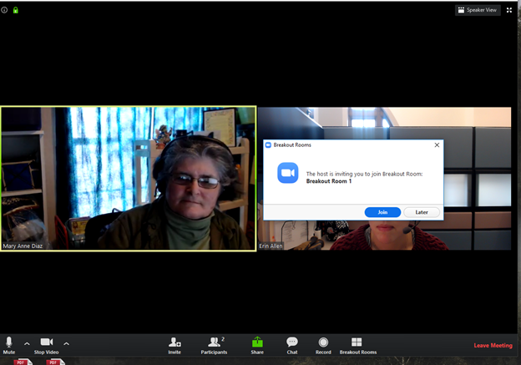
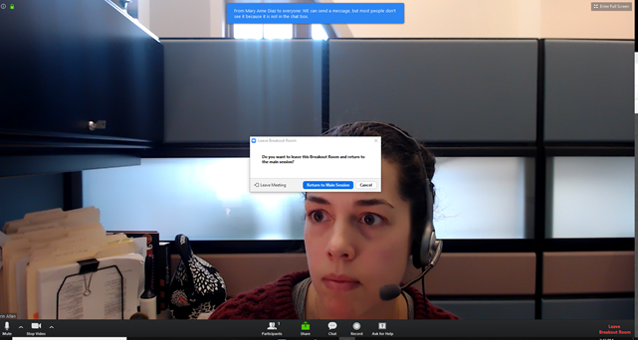
Click [JOIN] to go to your breakout room!
Inside the Breakout Room:
You can click [ASK FOR HELP], and the host will join your group.
If your group finishes early, you can click [LEAVE BREAKOUT ROOM], to return .

