Slide 1


NYS-MEP Required Student Data
Odilia Coffta
ID&R/MIS2000/MSIX

Slide 2
Things to Consider
Year 2 of 2025-28 Service Delivery Plan (SDP)
The SDP shows the goals we are trying to reach as NYS-MEP
These forms are great for collecting data and guide you with all the changes
All updated forms can be downloaded from our website: https://www.nysmigrant.org/resources/downloads/Student-Forms
Have a conversation with your Director

Slide 3
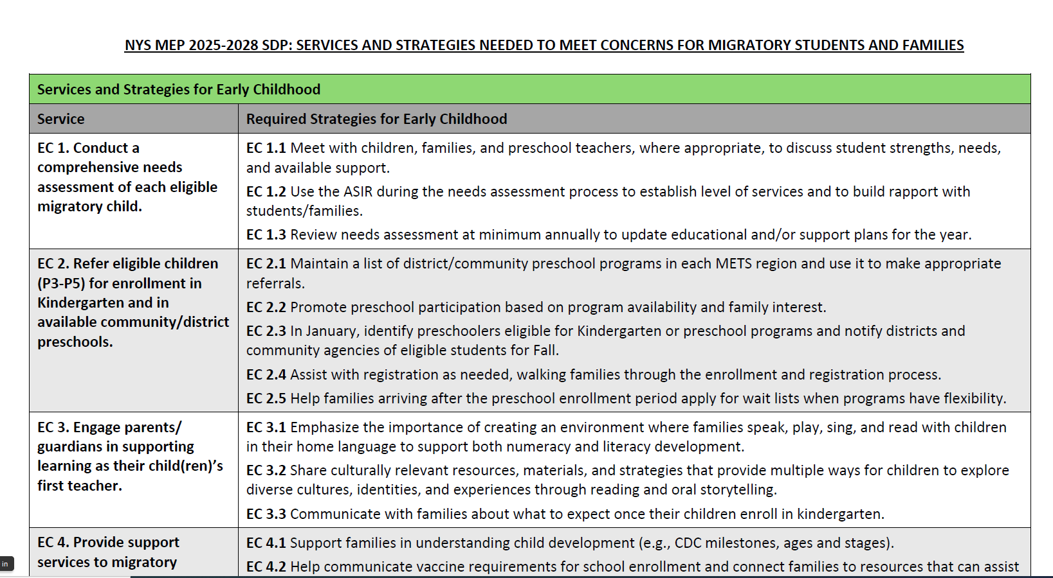

Slide 4
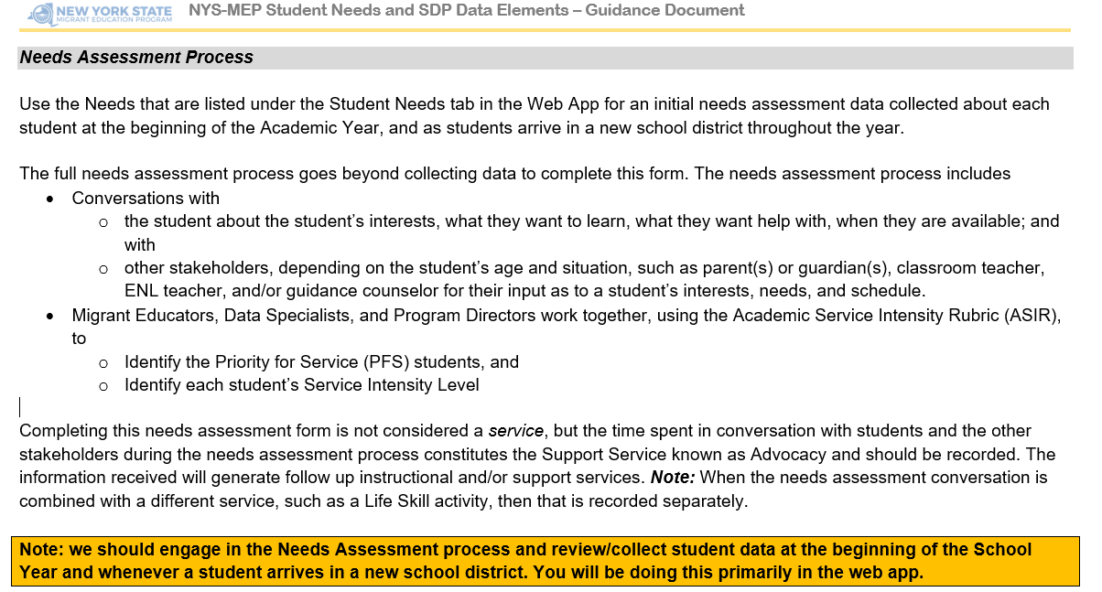

Slide 5
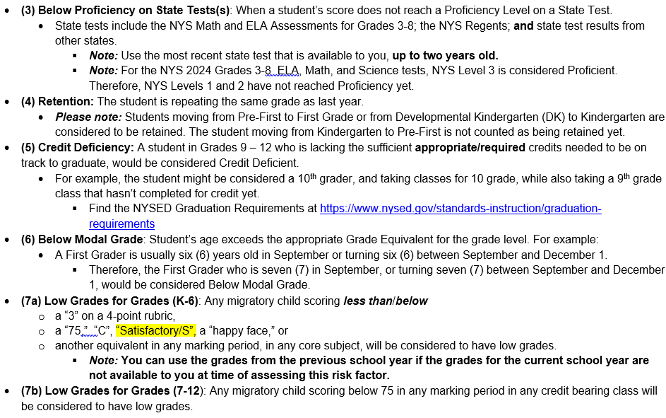

Slide 6
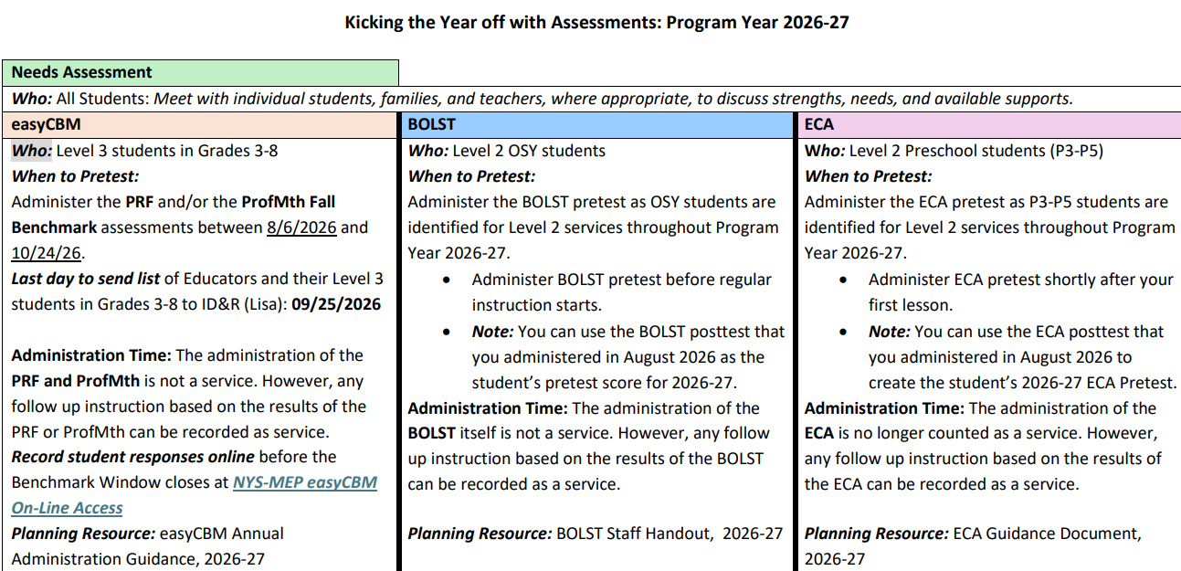

Slide 7
All Students!
Needs Assessment Process
Referrals, support for families and students in response to student needs
Facilitate student registration to local educational programs/school
Advocacy to self-advocacy, Family Engagement, Social and Emotional Learning

Slide 8
Needs Assessment Process
Goes beyond collecting the data to complete this form
Includes conversations with:
  the student about the student’s interests, what they want to learn, what they want help with, when they are available; and with
  other stakeholders, depending on the student’s age and situation, such as parent(s) or guardian(s), classroom teacher, ENL teacher, and/or guidance counselor for their input as to a student’s interests, needs, and schedule.
Migrant Educators, Data Specialists, and Program Directors work together, using the Academic Service Intensity Rubric (ASIR), to
  Identify the Priority for Service (PFS) students, and
  Identify each student’s Service Intensity Level

Slide 9
Important!
The Needs Assessment should happen within an adequate timeframe from receiving the COE or the beginning of the school year
You should update/review the Needs of the student at least once after doing the initial needs assessment
Completing this needs assessment form is not considered a service, but the time spent in conversation with students and the other stakeholders during the needs assessment process constitutes the Support Service known as Advocacy and should be recorded.
The information received will generate follow up instructional and/or support services.
Note: If the needs assessment conversation is combined with a different service, such as a Life Skill activity, then that is recorded separately.

Slide 10
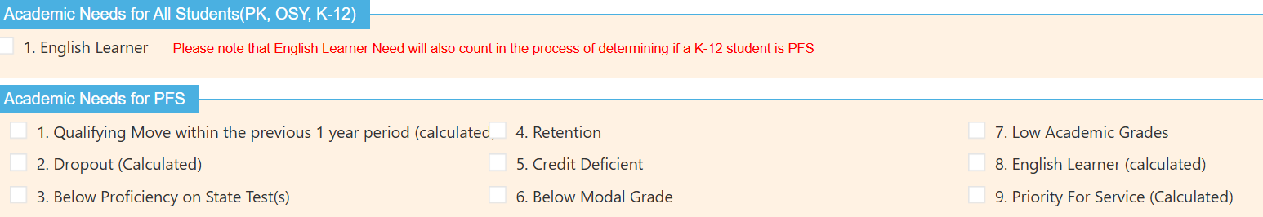
Academic Needs
Note: if you click on English Learner under “Academic Needs for All Students (PK, OSY, K-12), the system will automatically marked a K-12 student English Learner under “Academic Needs for PFS”

Slide 11
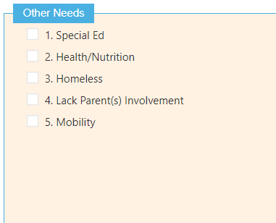
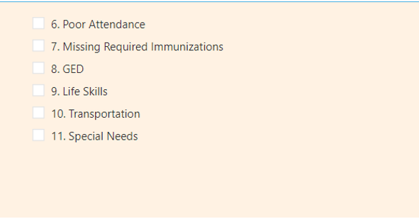
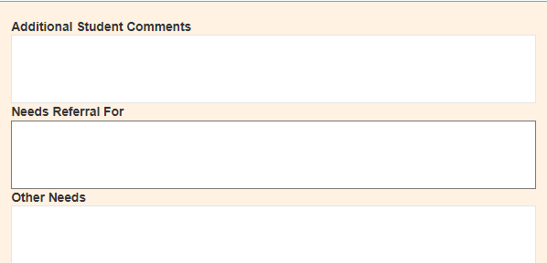
Other Needs for ALL Students

Slide 12
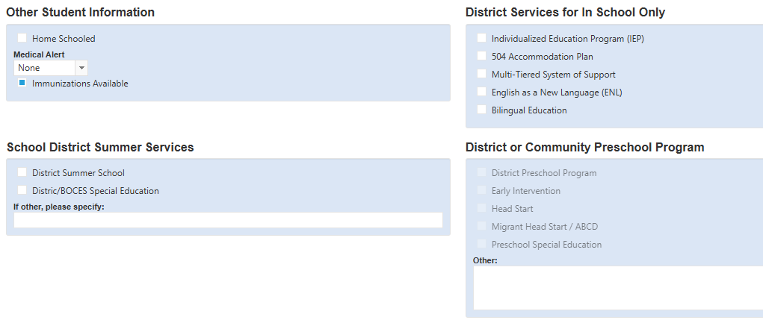
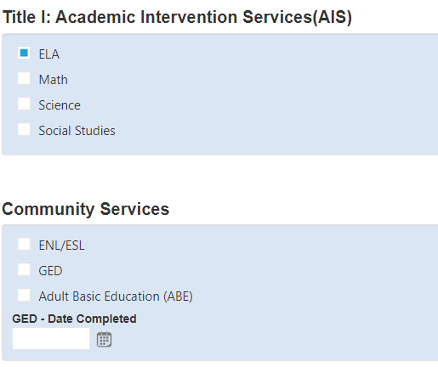

Slide 13
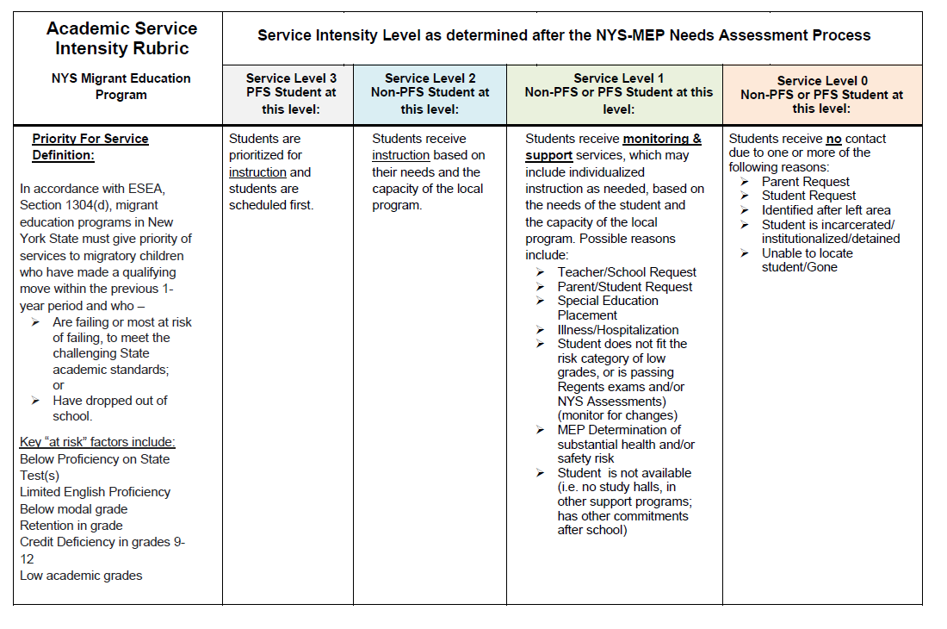

Slide 14
Let’s tailor this for K-8 students.
What type of referrals you typically give for this grade group? What about family engagement?
Needs Assessment Process
Referrals, support for families and students in response to student needs
Facilitate student registration to local educational programs/school
Advocacy to self-advocacy, Family Engagement, Social and Emotional Learning

Slide 15
Grades K-8
Level 3 (PFS)
Instructional Service in either: ELA or Math
Level 2
Instructional Service based on needs and local capacity
Level 1
Support services in response to needs and interest
Grade 3-8: Pretest and Posttest using EasyCBM

Slide 16
IMPORTANT!
Required: Grade 3-8 students that are Level 3 will be pretested in EasyCBM Passage Reading Fluency (PRF) and/or EasyCBM Proficient Math
Not specific number of hours but please check with your Director!!

Slide 17
Let’s tailor this for 9-12 students.
What type of referrals you typically give for this grade group? What about advocacy or teaching them self-advocacy?
Needs Assessment Process
Referrals, support for families and students in response to student needs
Facilitate student registration to local educational programs/school
Advocacy to self-advocacy, Family Engagement, Social and Emotional Learning

Slide 18
Grades 9-12
Level 3 (PFS)
Discuss student interests and goals
Review transcript and schedule to identify concerns
Level 2
Discuss student interests and goals
Review transcript and schedule to identify concerns
Level 1
Review transcript and schedule to identify concerns
Discuss student interests and goals
Instructional Service Hours in response to academic needs and interests
Instructional Service Hours based on needs and local capacity
Support Services in response to needs and interests

Slide 19
Dropout Students
Level 3 (PFS)
Establish contact with student within 45 days after learning student left school
Use OSY Profile to prompt discussion about student needs, interests, goals
Level 2
Establish contact with student within 45 days after learning student left school
Level 1
Use OSY Profile to prompt discussion about student needs, interests, goals
Establish contact with student within 45 days after learning student left school
Instructional Service Hours in response to needs
Instructional Service Hours based on needs and local capacity
Support Services in response to needs and interests
Use OSY Profile to prompt discussion about student needs, interests, goals

Slide 20
OS and D+
Level 2
Level 1
Use OSY Profile to prompt discussion about student needs and interests
Use OSY Profile to prompt discussion about student needs and interests
Personal Learning Plan to capture student’s short term goal
Support Services in response to needs and interests
Instructional Services per student goals: ENL, Life Skills, other
Pretest/Posttest BOLST for students participating in ENL instruction

Slide 21
Let’s tailor this for PK students.
What type of advocacy do you provide for this group of students? What type of information are you sharing with the families?
Needs Assessment Process
Referrals, support for families and students in response to student needs
Facilitate student registration to local educational programs/school
Advocacy to self-advocacy, Family Engagement, Social and Emotional Learning

Slide 22
Preschool (P3-P5)
Level 2
Level 1
Referral to District Kindergarten or to Community/District Preschool
Pretest and posttest with Early Childhood Academic Tool (ECA)
Support Services in response to needs and interests
Instructional Service hours in ELA, ENL, and Math per student needs and interests

Slide 23
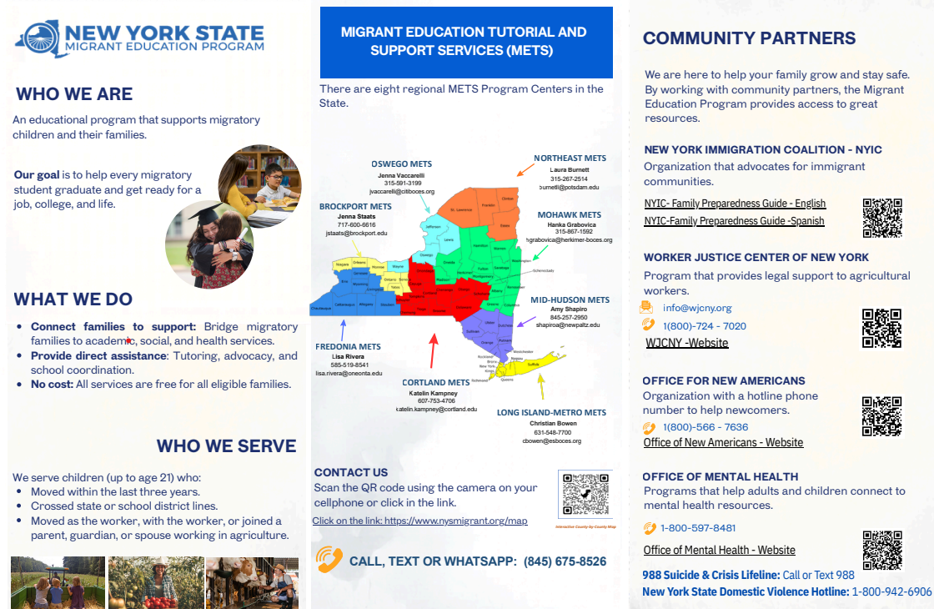
Great New Resource for Parents and OSY

Slide 24
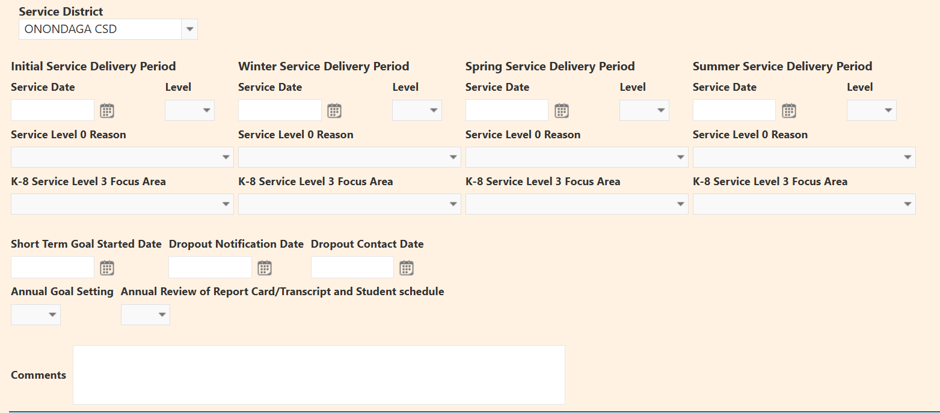
Service Delivery- Data Related to State Goals

Slide 25
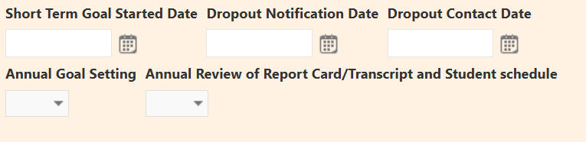
Service Delivery- A Closer Look
Many of these data fields might be empty when you complete the needs assessment or leveling process
You do not need to complete the annual goal setting at the same time as the Needs Assessment Process
Same with the OSY Personal Learning Plan (Short Term Goal Started)
We might also learn about a student dropping out of school on a different date
Your Data Specialists will remind you about any missing data
When in doubt, ask your Director

Slide 26
Important!
The OSY Profile needs to be completed for all OSY/D+/recently DO students annually
Just like the Needs Assessment in the Intake form, the process of completing the OSY Profile should go beyond collecting the data
Take this opportunity to:
  Learn about the student’s interests
  what they want to learn
  what they want help with
  when they are available
Completing this OSY Profile form is not considered a service, but the time spent in conversation with students and the other stakeholders during the needs assessment process constitutes the Support Service known as Advocacy and should be recorded
Reminder: as of 24/25, the OSY Profile data will be rolled over to the new enrollment line. Make sure you still take time to update the data annually!

Slide 27
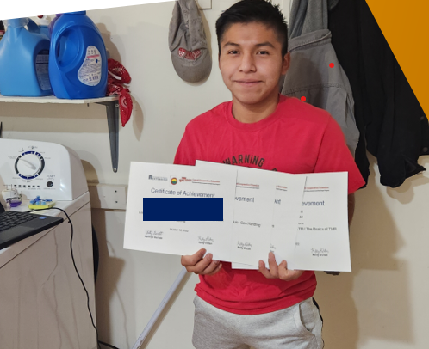
Personal Learning Plan

Slide 28
Personal Learning Plan
No changes!
Use this form to help your OSY identify long-term and short-term goals
You can have as many PLPs as you wish
Please make sure you report if the “student made any progress toward their goals”
You can access the PLP training video here

Slide 29
What are services?
Services are a subset of all allowable activities that the MEP can provide through its programs and projects. “Services” are those educational or educationally related activities that:
●directly benefit a migrant child;
●address a need of a migrant child consistent with the State’s comprehensive needs assessment and service delivery plan;
●are grounded in scientifically based research or, in the case of support services, are generally accepted practices; and
●are designed to enable the program to meet its measurable outcomes and contribute to the achievement of the State’s performance targets and annual measurable objectives.

Slide 30
We are also allowed to carry activities related to the MEP, but we cannot count such activities as services
Activities related to identification and recruitment activities, parental involvement, program evaluation, professional development, or administration of the program are examples of allowable activities that are not considered services. Another example would be handing out leaflets to migrant families on available reading programs as part of an effort to increase the reading skills of migrant children.

Slide 31
Supplemental Service Codes- What Stays the Same
Advocacy ☺
Counseling Services (certified counselor)
Transportation
ENL
English Language Arts
Life Skills
Mathematics
Science
Social Studies

Slide 32
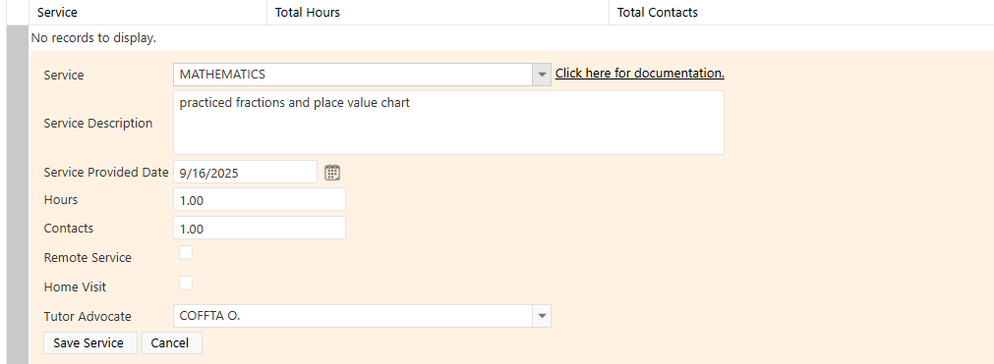
Supplemental Service Codes- What Changed?
If a service was provided at home, please use the At Home Check Box
We added Attempted/No Service
  Implemented Summer 2023
  Use this code when you attempted to provide services to a student but you were not able to provide such service.
  No Advocacy!

Slide 33
Supplemental Service Codes- What Changed?
We removed: Preschool and Elementary Activities & Adolescent Activities
We added: Enrichment Activity
Use this code for:
  Services/support for students that include, culturally responsive:
    identity development activities, community service, and/or educational field trips;
    career related activities coordinated by local/statewide MEP that provide students opportunities to explore and/or visit job sites, tour colleges/universities and vocational programs and meet with role models. NOTE: Any instructional component provided during an enrichment activity should be recorded separately with its instructional code. Sample scenario: Students participated on a State Park visit where a lesson was provided. For example, if there is a lesson about habitats and water cycle for the first 30 minutes of the enrichment activity, you will record it as following: Enrichment Activity (C=1 H=4) and Science (C=1 H=0.5)

Slide 34
Supplemental Service Codes- What Changed?
We added: School Enrollment
Use this code to record:
Support to families for PK-12/DO student initial school enrollment, included but not limited to:
  transportation to appointments that will result in school enrollment
  support in securing require vaccinations
  support in appointment with school registration
  support on coordinating bus transportation including pick-up/drop-off locations

Slide 35
Supplemental Service Codes- What Changed?
New this year! Date Service Provided should match the date that the service was rendered
Example:

Slide 36
Let’s Chat about the Description Box
Powerful Tool to let Directors/Data Specialists know what you worked on, the progress of the student, and other skills you might work with them next
The information you add in the Description Box should follow your Directors’ requirements
From the State:
  Specific
  Inform what skills you were working with the student
  Concise
  Confidential information

Slide 37
Examples:
ENL: Learned about personal information, colors and numbers. Next meeting we will review personal information and learn about Reading Maps
Advocacy: 7.17.25 HV the family, let the student choose a book to read for the summer. Also, I invite her to participate virtually with the group of adolescents in different activities. She was enthusiastic, and Mom was pleased that she kept her busy.

Slide 38
Examples:
Mathematics: At home tutoring using summer bridge books, the student completed lesson on exponents, and large number division and multiplication.
Advocacy: ASSISTING WITH OBTAINING INFO IN REGARDS TO BUS AND SOCCER PRACTICES. WILL MAKE HOME VISIT NEXT WEEK IN REGARDS TO SCHEDULE AND AVAILABILITY

Slide 39
Examples of what not to do:
Advocacy: Texted OSY, no answer.
Advocacy: dropped off school supplies
Advocacy: sent link to student for online english class. Student said thank you
Advocacy: I sent Juan the OSY workshop flyer but I am pretty sure he is working during that time. I can see he read my message

