Slide 1

Protecting Your Children
What Parents Need To Know About Bullying
Tracey D. Messinger, M.S. Ed.
Reporting
English

Slide 2



Housekeeping

Slide 3
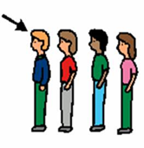



Statistics about Bullying
1 in 4 students bullied
Every 7 minutes
1 in 5 admits to bullying
1 in 10 drops out of school

Slide 4
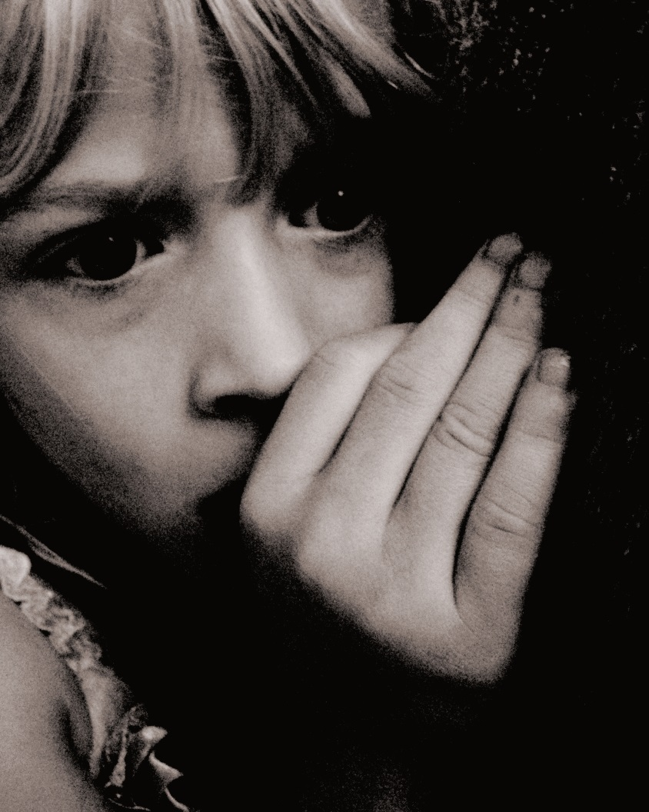
Why Don’t Students Report Bullying?
Notes:
Brainstorm list

Slide 5
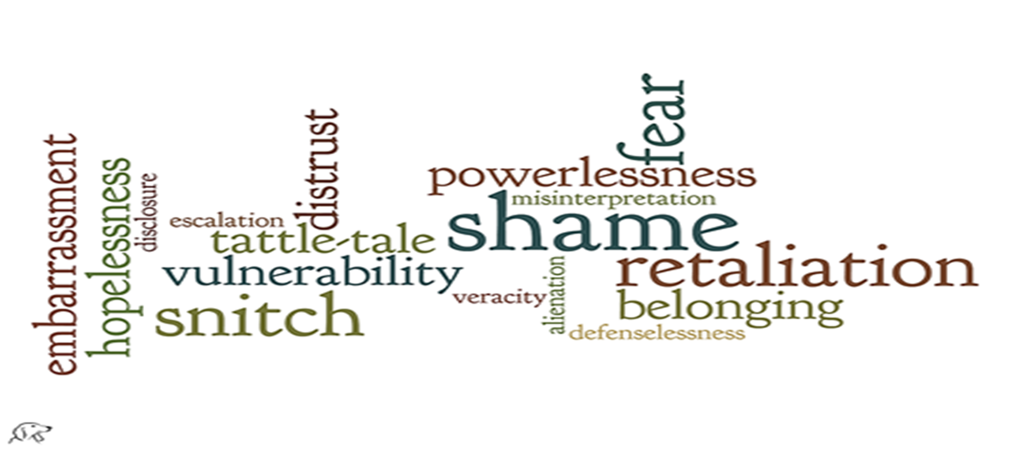
What Prevents Reporting?

Slide 6

How to Report
Report to school (who?)
Say something
Report to police

Slide 7
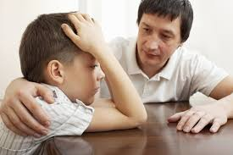
Practice Reporting to School
Role Plays
Notes:
Group activity 4: use scenarios in group. Group decides who to report to and how to support student.

Slide 8
Bullying Is About Power
Power Over Others Power With Others

Slide 9
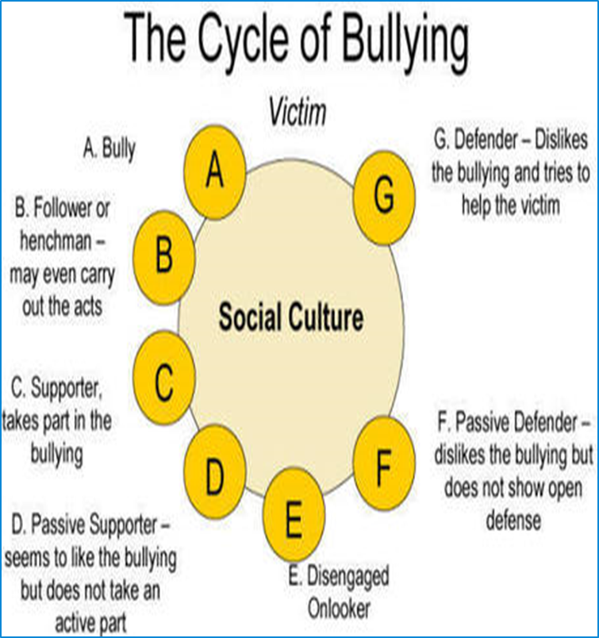
Bystander to Advocate
Other people involved in Bullying
Skills students need?
Notes:
Brainstorm skills students need to report and why they may be afraid to report.

Slide 10
Dominant | Excluded | Oppression | NYS DASA Covered Groups
White People | People of Color | Racism | Race, Color
Magazine Look | Everyone Else | Lookism | Weight
Citizen | Undocumented or Resident | Nativism | National Origin/ Ethnicity
“Standard” English | Non-English speaking, English with accent, dialect of English, low English literacy | Linguisicsm | National Origin/Ethnicity
Christian | All other Spiritual Beliefs | Christian Hegemony | Religion Religious Practice
People without disAbilities | People with disAbilities | Ableism | Disability
Heterosexual | Gay, Lesbian, Bisexual, Questioning… | Heterosexism | Sexual Orientation
Males | Females, Intersex, Non-binary… | Sexism | Gender, Sex
Cisgender People | Transgender people, Gender Non-Conforming … | Cissexism | Gender Identity, Gender Expression
Notes:
Covered Groups (A)

Slide 11
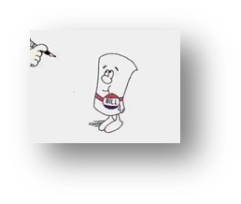

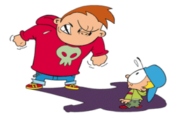
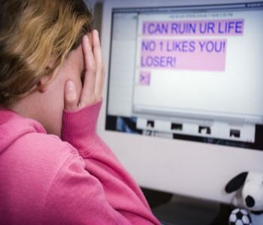

DASA Legislation
Dignity for All Students Act
Legislation 2012
Bullying, Harassment and Discrimination
Amended 2013
Cyberbullying

Slide 12


Covered Groups: NYS (11)
Race
Color
Weight
National Origin/Ethnicity
Religion
Religious Practice
Disability
Sexual Orientation
Gender
Gender Identity or Expression
Sex
Code of Conduct Issues
  Other acts of bullying not covered under protected groups
  Examples: poverty, being weird, different, tall, short, athletic, musical, etc.

Slide 13



Helping Your Students
Speak up
Filter—Is it true?
Post less
Don’t over share
Practice
Develop coping skills
Expectations and limits
Work with school

Slide 14
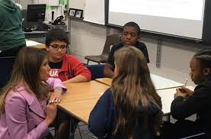

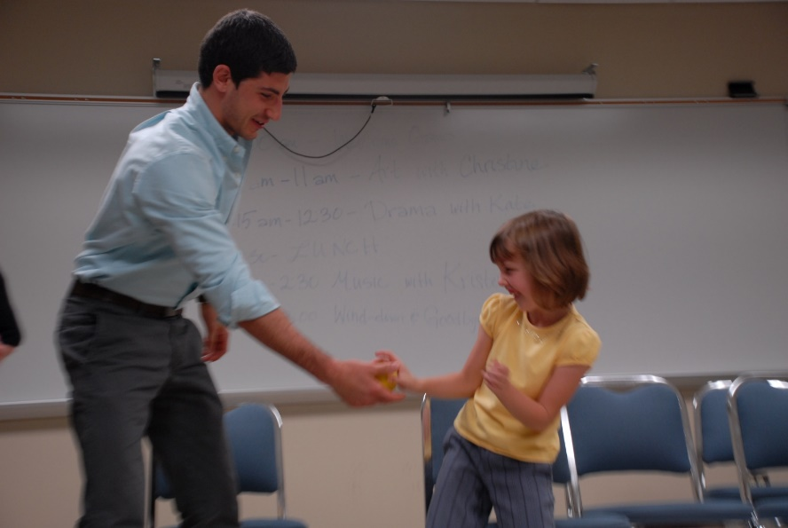
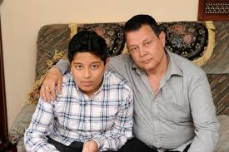

Resources for Helping Students
Notes:
See list of resources for parents online, brain storm additional resources

Slide 15

Questions
Questions not answered?

Slide 16


