Slide 1
Developing Effective Communication Skills
An Overview of Intergroup Dialogue

Slide 2

What is Effective Communication?

Slide 3

Purposeful Sending

Slide 4

Active Listening

Slide 5

Body Language & Non-Verbal Cues

Slide 6
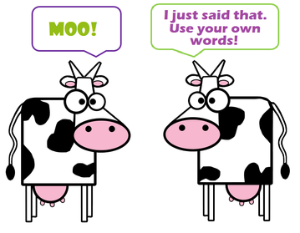
Paraphrasing

Slide 7


