Slide 1

oif.uav;rsm;udk umuG,fay;jcif;
Introduction to the NYS DASA Legislation

Slide 2

tdrfudk xdef;odrf;apmifha&Smufjcif;

Slide 3
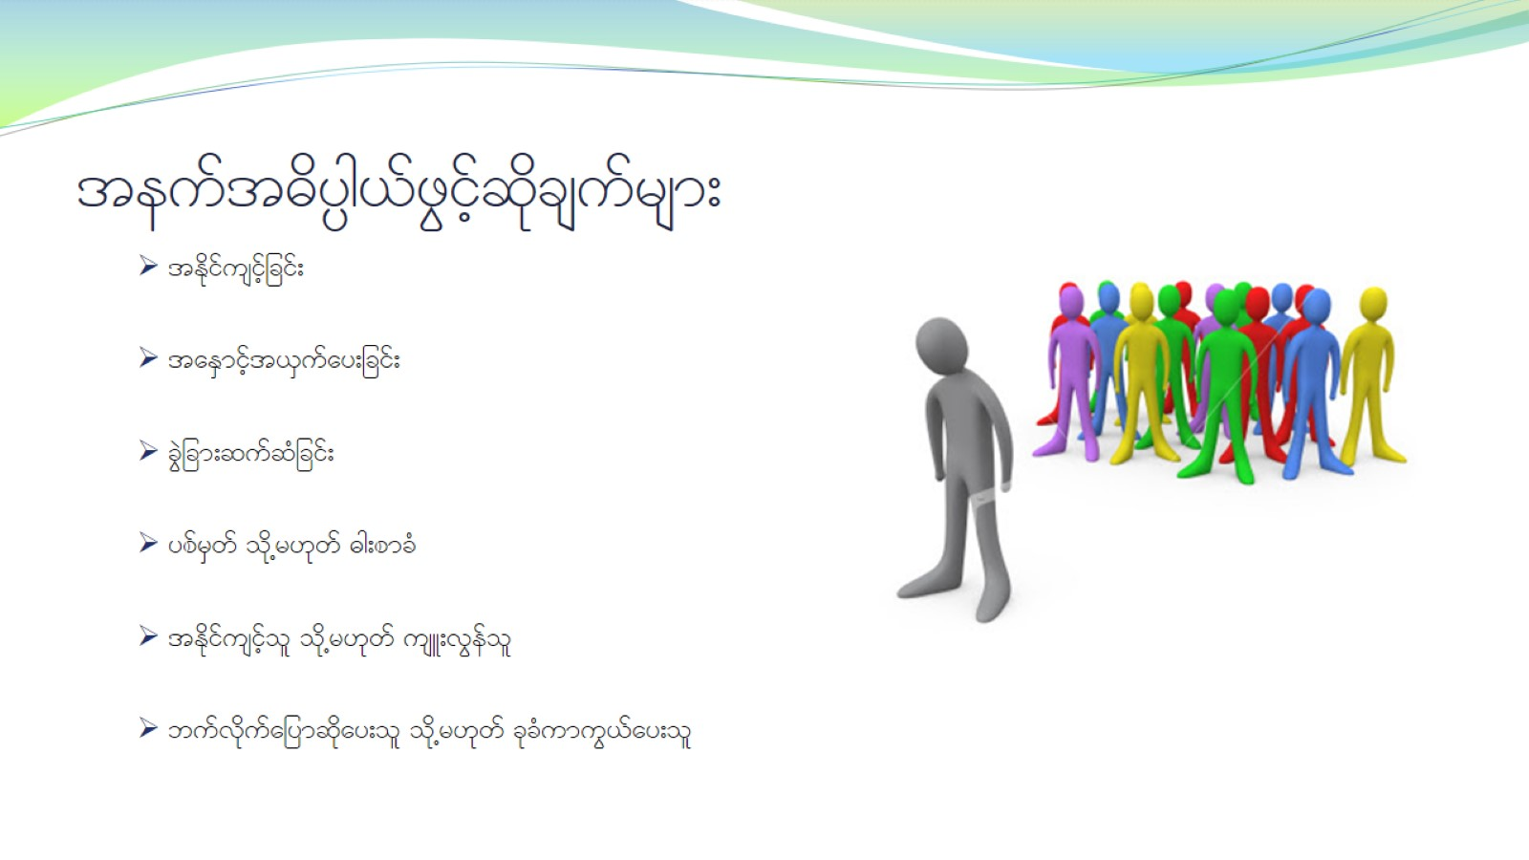
teuft"dy`g,fzGifhqdkcsufrsm;

Slide 4
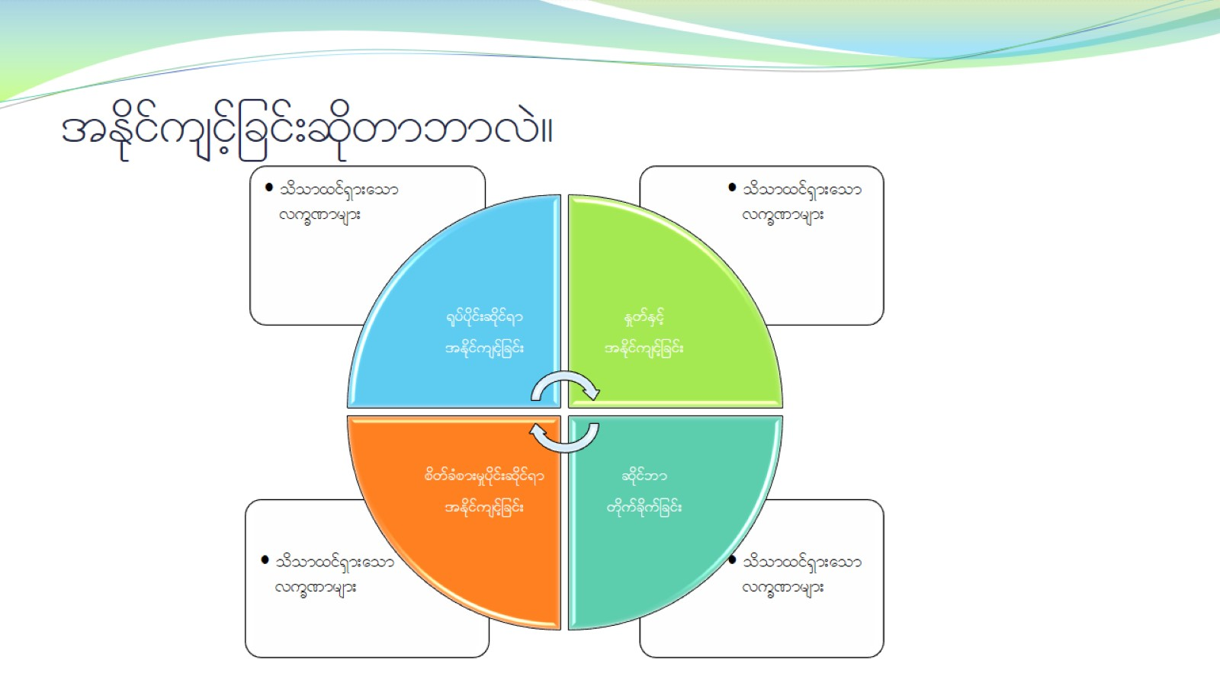
tEdkifusifhjcif;qdkwmbmvJ?

Slide 5

pum;rajymqdkaomykHpHjzifh tEdkifusifhjcif;

Slide 6

rnfonfhae&mrsm;wGif tEdkifusifhjcif; jzpfysufEdkifovJ?

Slide 7

umuG,fay;jcif;cH&aom tkyfpkrsm; NYS (11)

Slide 8
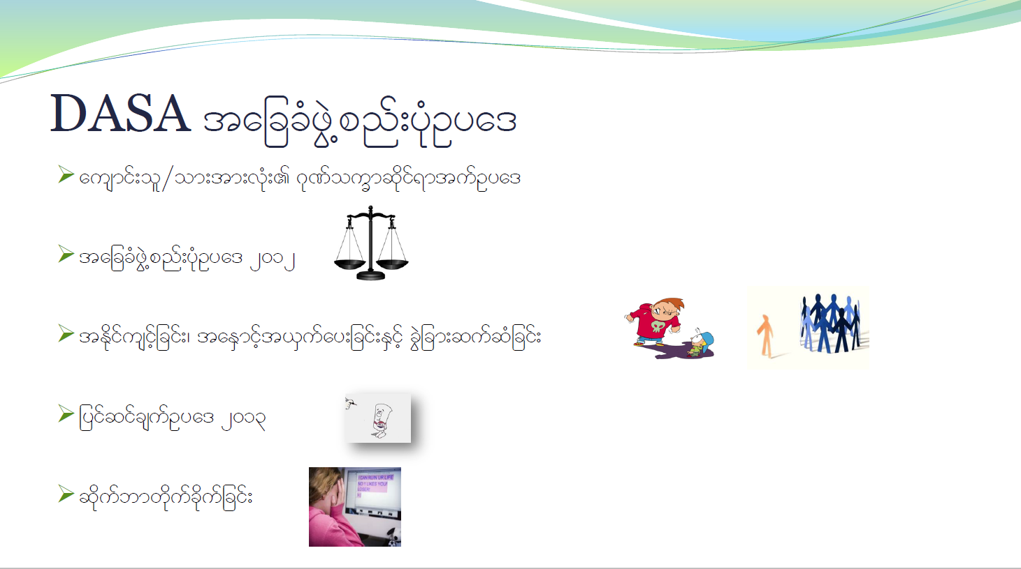
DASA tajccHzGJ@pnf;ykHOya'

Slide 9

ausmif;ol§om;rsm; tEdkifusifhjcif;udk bma=umifh owday;wdkif=um;jcif; rjyKvkyf=uovJ?

Slide 10

tb,ft&mu owif;ay;wdkif=um;jcif;udk wm;qD;ovJ- -

Slide 11

b,fvdk owif;ay;wdkiff=um;rvJ?

Slide 12

oif.ausmif;ol§om;rsm;tm; tultnDay;jcif;?

Slide 13

ausmif;ol§om;rsm;tm; tultnDay;&eftwGuf t&if;tjrpfrsm;

Slide 14

ar;cGef;rsm;

Slide 15

ed*kH;csKyfjcif;

