Slide 1

oif.uav;rsm;udk umuG,fay;jcif;
Reporting
Burmese

Slide 2

tdrfudk xdef;odrf;apmifha&Smufjcif;

Slide 3
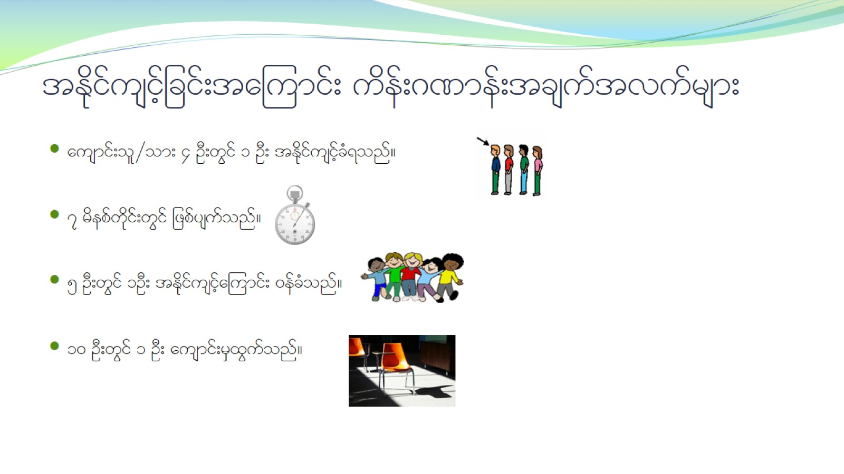
tEdkifusifhjcif;ta=umif; udef;*%mef;tcsuftvufrsm;

Slide 4
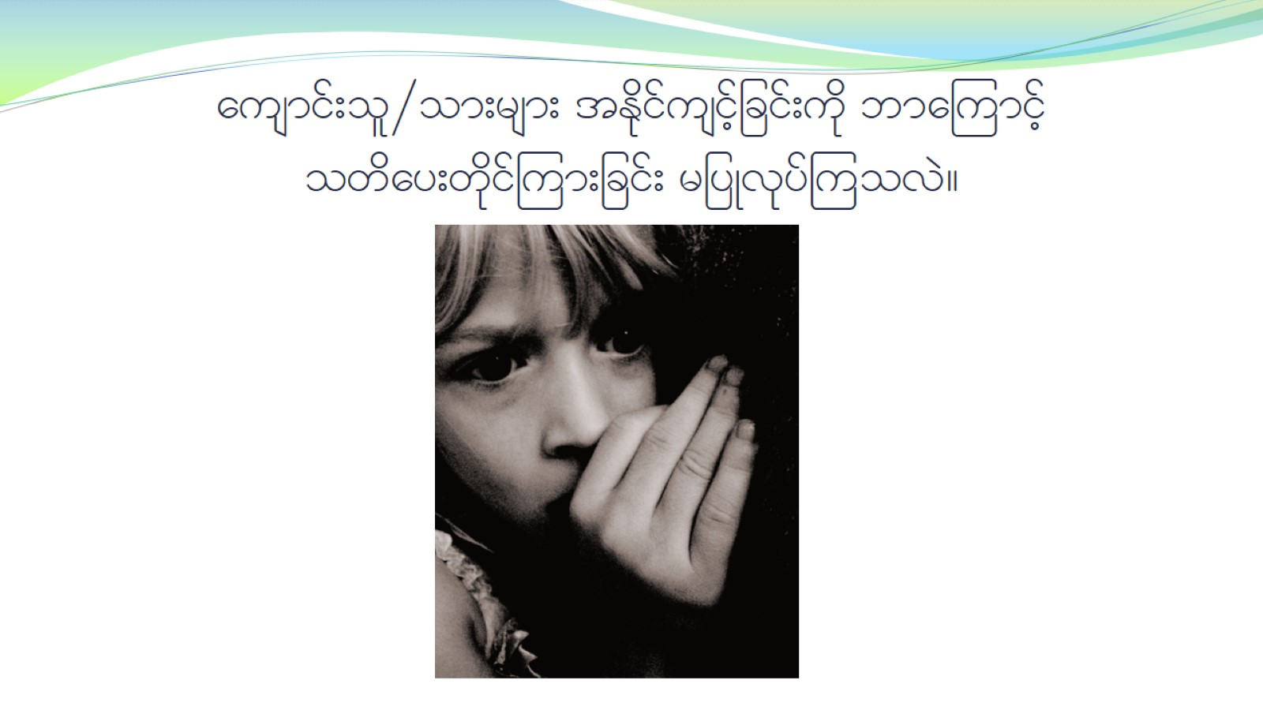
ausmif;ol§om;rsm; tEdkifusifhjcif;udk bma=umifh owday;wdkif=um;jcif; rjyKvkyf=uovJ?

Slide 5

tb,ft&mu owif;ay;wdkif=um;jcif;udk wm;qD;ovJ- -

Slide 6
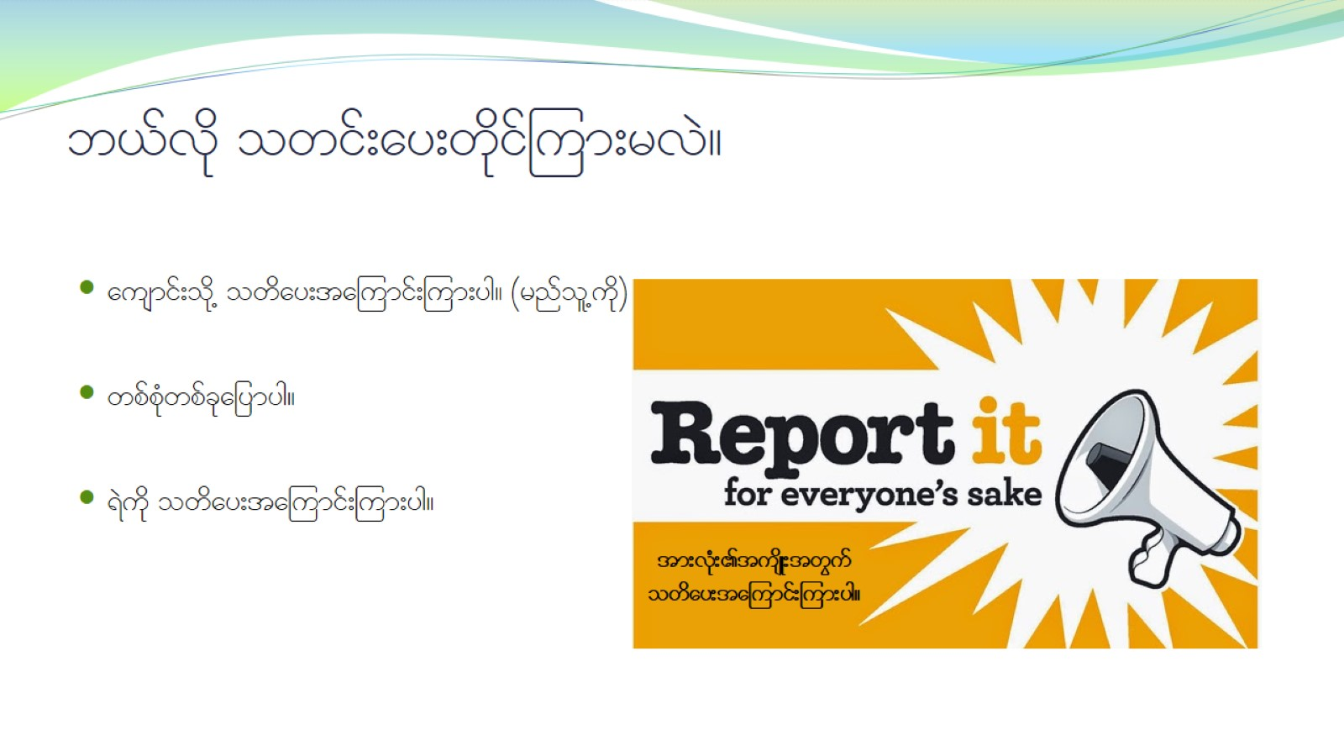
b,fvdk owif;ay;wdkiff=um;rvJ?

Slide 7
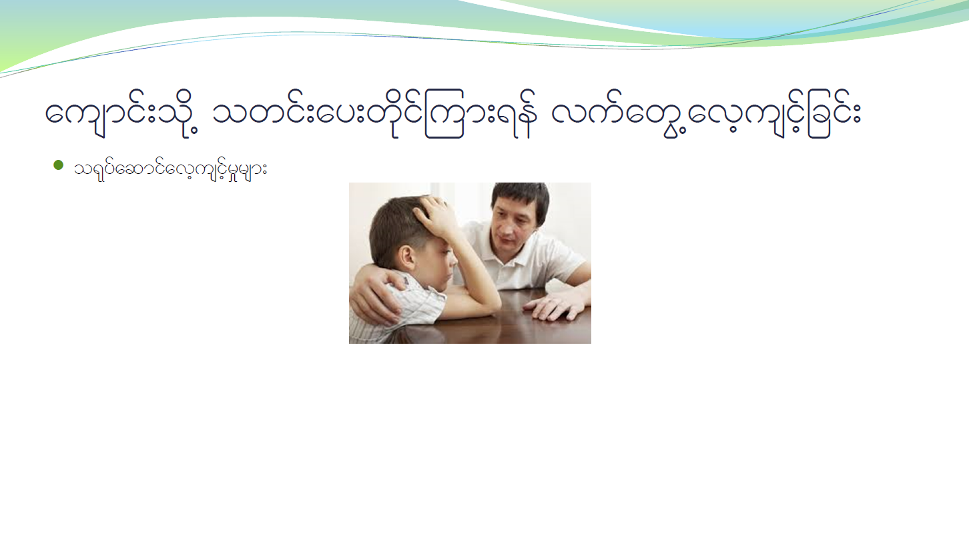
ausmif;okd@ owif;ay;wdkif=um;&ef vufawG@avhusifhjcif;

Slide 8
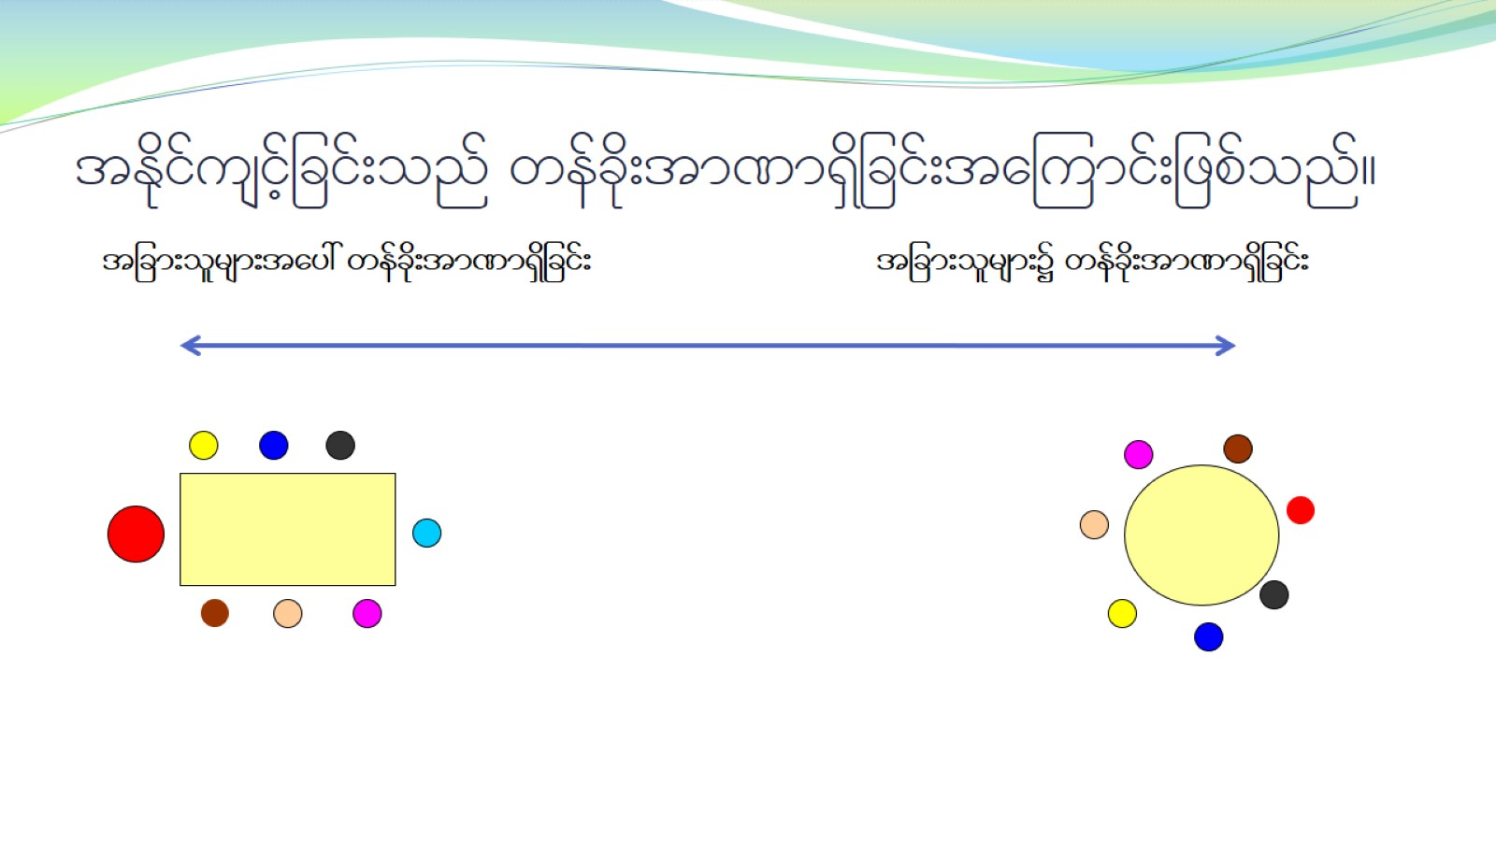
tEdkifusifhjcif;onf wefcdk;tm%m&Sdjcif;ta=umif;jzpfonf?

Slide 9
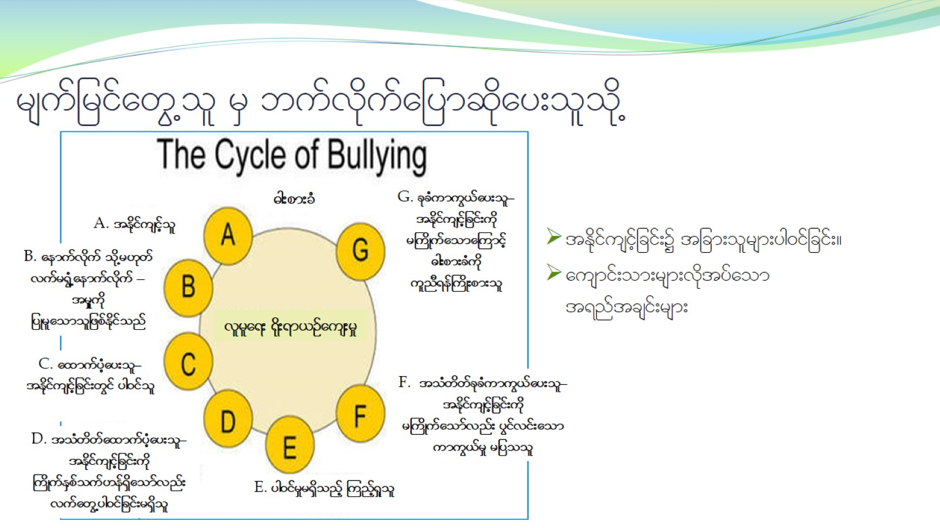
rsufjrifawG@ol rS bufvkdufajymqdkay;olodk@

Slide 10
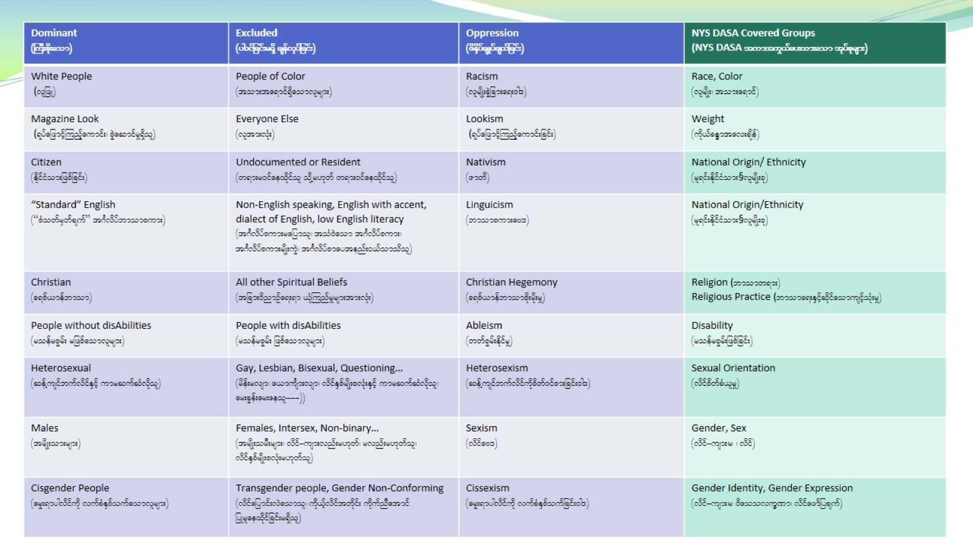

Slide 11
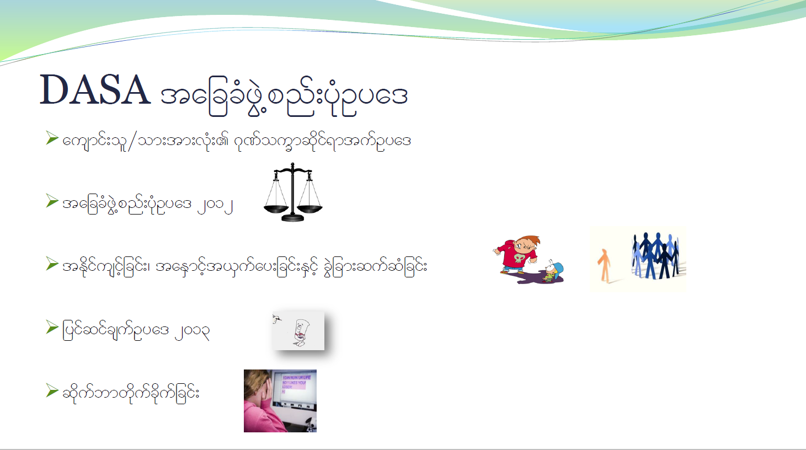
DASA tajccHzGJ@pnf;ykHOya'

Slide 12
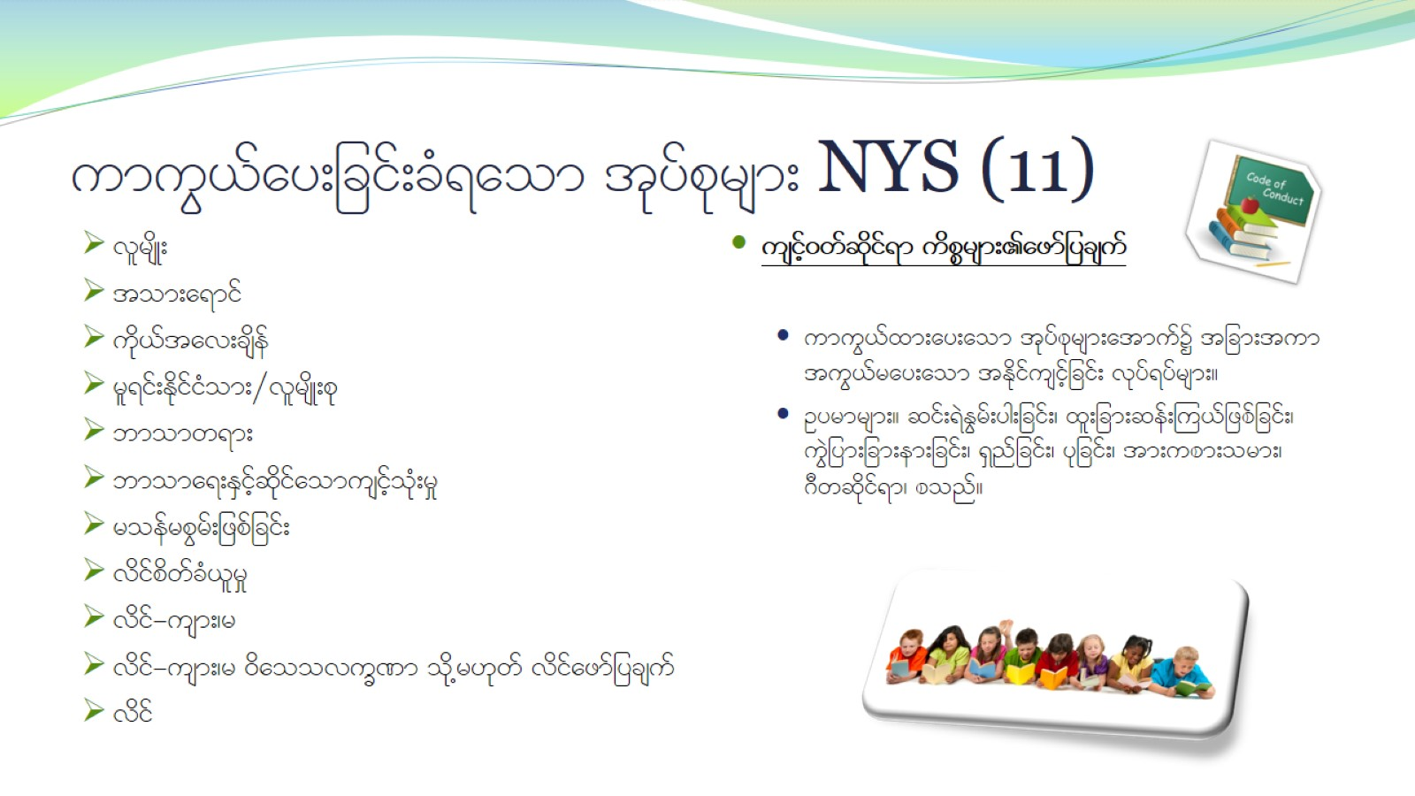
umuG,fay;jcif;cH&aom tkyfpkrsm; NYS (11)

Slide 13

oif.ausmif;ol§om;rsm;tm; tultnDay;jcif;?

Slide 14
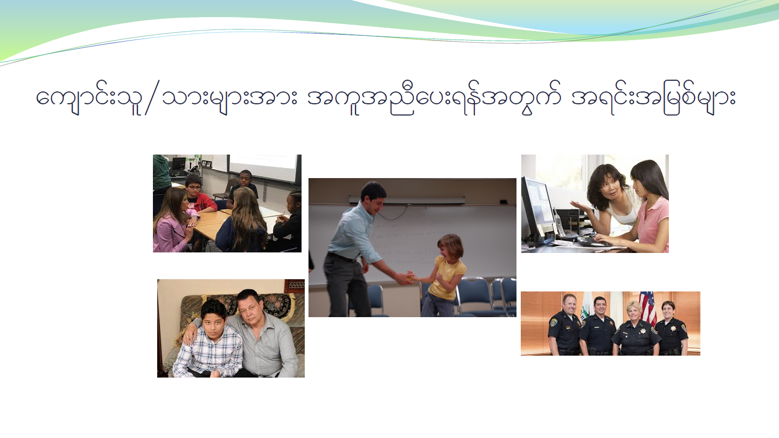
ausmif;ol§om;rsm;tm; tultnDay;&eftwGuf t&if;tjrpfrsm;

Slide 15

ar;cGef;rsm;

Slide 16
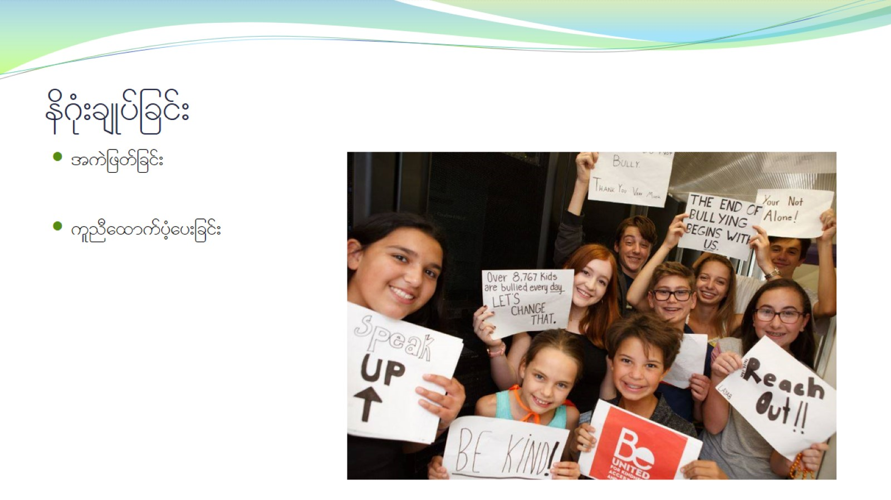
ed*kH;csKyfjcif;

