Slide 1

Basic Oral Language Screening Tool (BOLST)
(2025-26 Version)

Slide 2


Section 1- Introductions & Greetings
1. Hi, How are you?
2. What is your name?
3. What day is today?
4. How old are you?

Slide 3
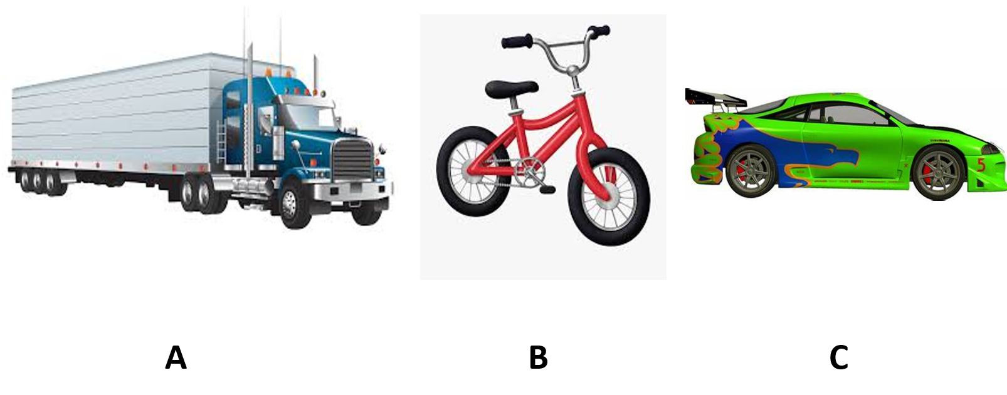
Section 2- Auditory Comprehension
1

Slide 4
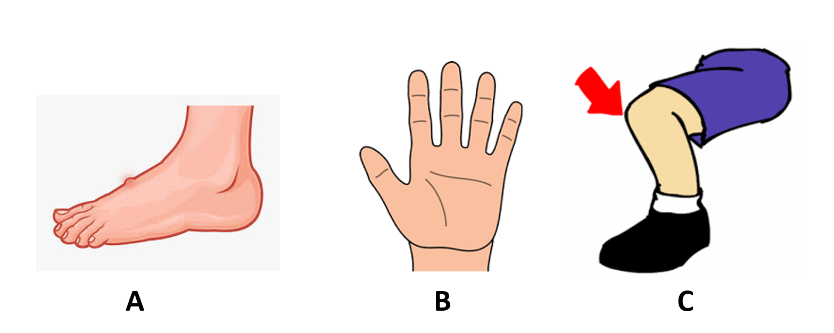
Section 2- Auditory Comprehension
2

Slide 5
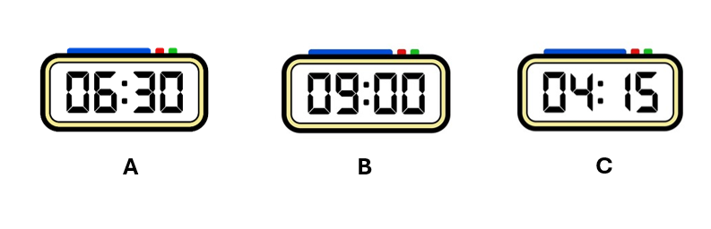
Section 2- Auditory Comprehension
3

Slide 6
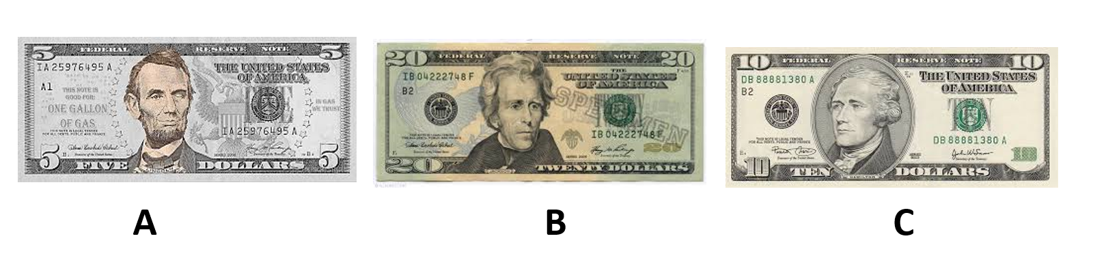
Section 2- Auditory Comprehension
4

Slide 7
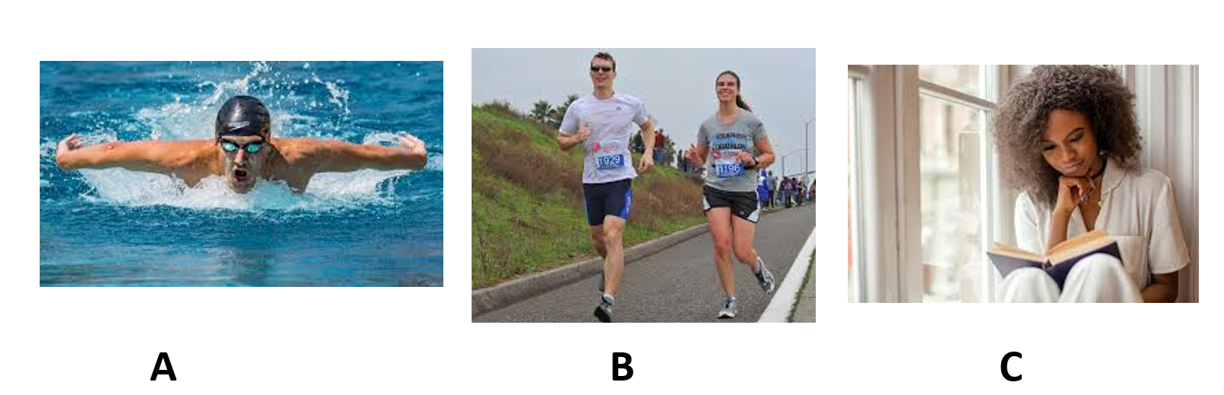
Section 2- Auditory Comprehension
5

Slide 8
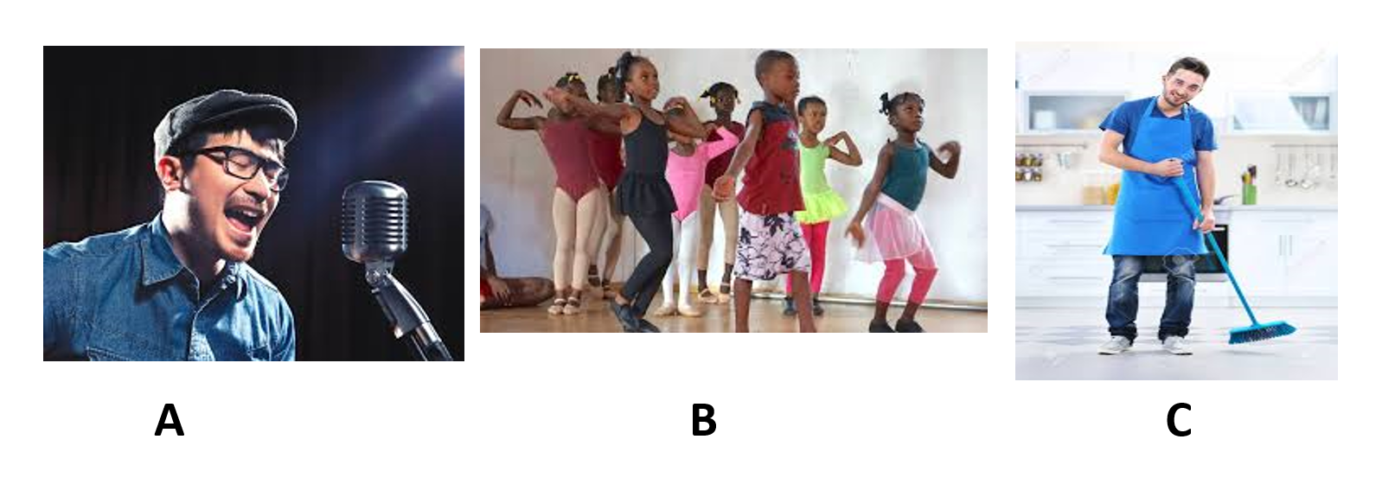
Section 2- Auditory Comprehension
6

Slide 9
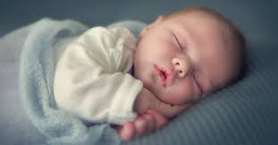
Section 3- Ability to Produce Basic Language
1

Slide 10
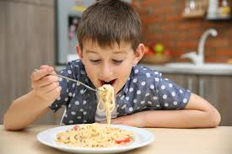
Section 3- Ability to Produce Basic Language
2

Slide 11
Section 3- Ability to Produce Basic Language
3

Slide 12
Section 3- Ability to Produce Basic Language
4

Slide 13
Section 3- Ability to Produce Basic Language
5

Slide 14

Section 4: Beginning Literacy Skills
1.What letter is this? ¿Qué letra es esta?

Slide 15

Section 4: Beginning Literacy Skills
1.What letter is this? ¿Qué letra es esta?

Slide 16

Section 4: Beginning Literacy Skills
1.What letter is this? ¿Qué letra es esta?

Slide 17

Section 4: Beginning Literacy Skills
1.What letter is this? ¿Qué letra es esta?

Slide 18

Section 4: Beginning Literacy Skills
2. What is this number? ¿Qué número es este?

Slide 19
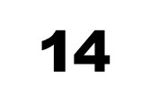
Section 4: Beginning Literacy Skills
2. What is this number? ¿Qué número es este?

Slide 20
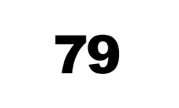
Section 4: Beginning Literacy Skills
2. What is this number? ¿Qué número es este?

Slide 21
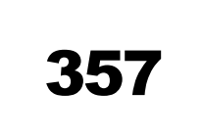
Section 4: Beginning Literacy Skills
2. What is this number? ¿Qué número es este?

Slide 22

Section 4: Beginning Literacy Skills
3. What is this word? ¿Puedes decir esta palabra?

Slide 23

Section 4: Beginning Literacy Skills
3. What is this word? ¿Puedes decir esta palabra?

Slide 24

Section 4: Beginning Literacy Skills
3. What is this word? ¿Puedes decir esta palabra?

Slide 25

Section 4: Beginning Literacy Skills
3. What is this word? ¿Puedes decir esta palabra?

Slide 26
Section 5- Ability to Produce Expanded Responses and Language
1

Slide 27
Section 5- Ability to Produce Expanded Responses and Language
2

Slide 28
Section 5- Ability to Produce Expanded Responses and Language
3

Slide 29
Section 5- Ability to Produce Expanded Responses and Language
4

